Slide 1
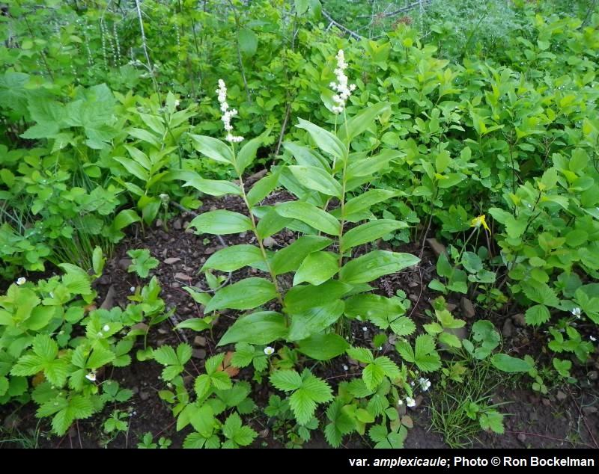
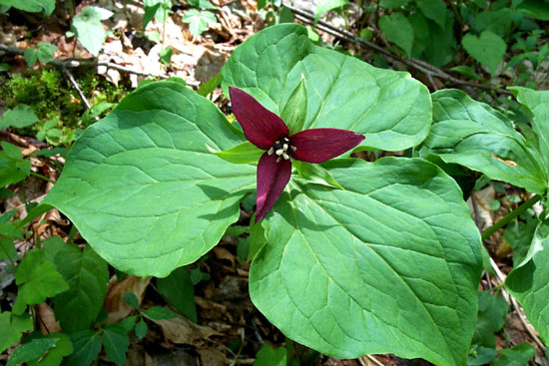
Allelopathy-mediated plant invasion facilitates reduced leaf-level photosynthesis in two native understory species
Maianthemum racemosum
Evan Perkowski
TTUCC Science Meeting
March 21, 2024
Trillium spp.

Slide 2
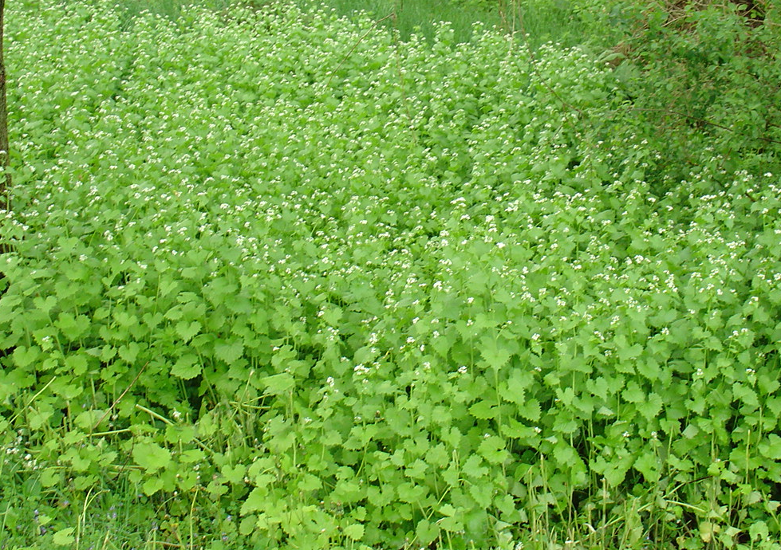
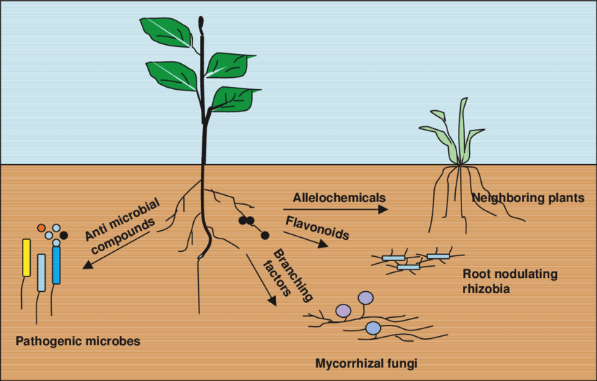
Invasive species exploit strategies that maximize fitness in novel environments
Decreasing available light
to neighbor plants
Producing compounds that are toxic to
soil microbes and neighbor plants
Notes:
Early emergence to take advantage of soil resources
Used to increase vertical growth and shade out neighboring species
Used to produce secondary metabolites that are toxic to neighboring roots or soil microbial communities that play a large role in regulating nutrient biogeochemical cycles

Slide 3
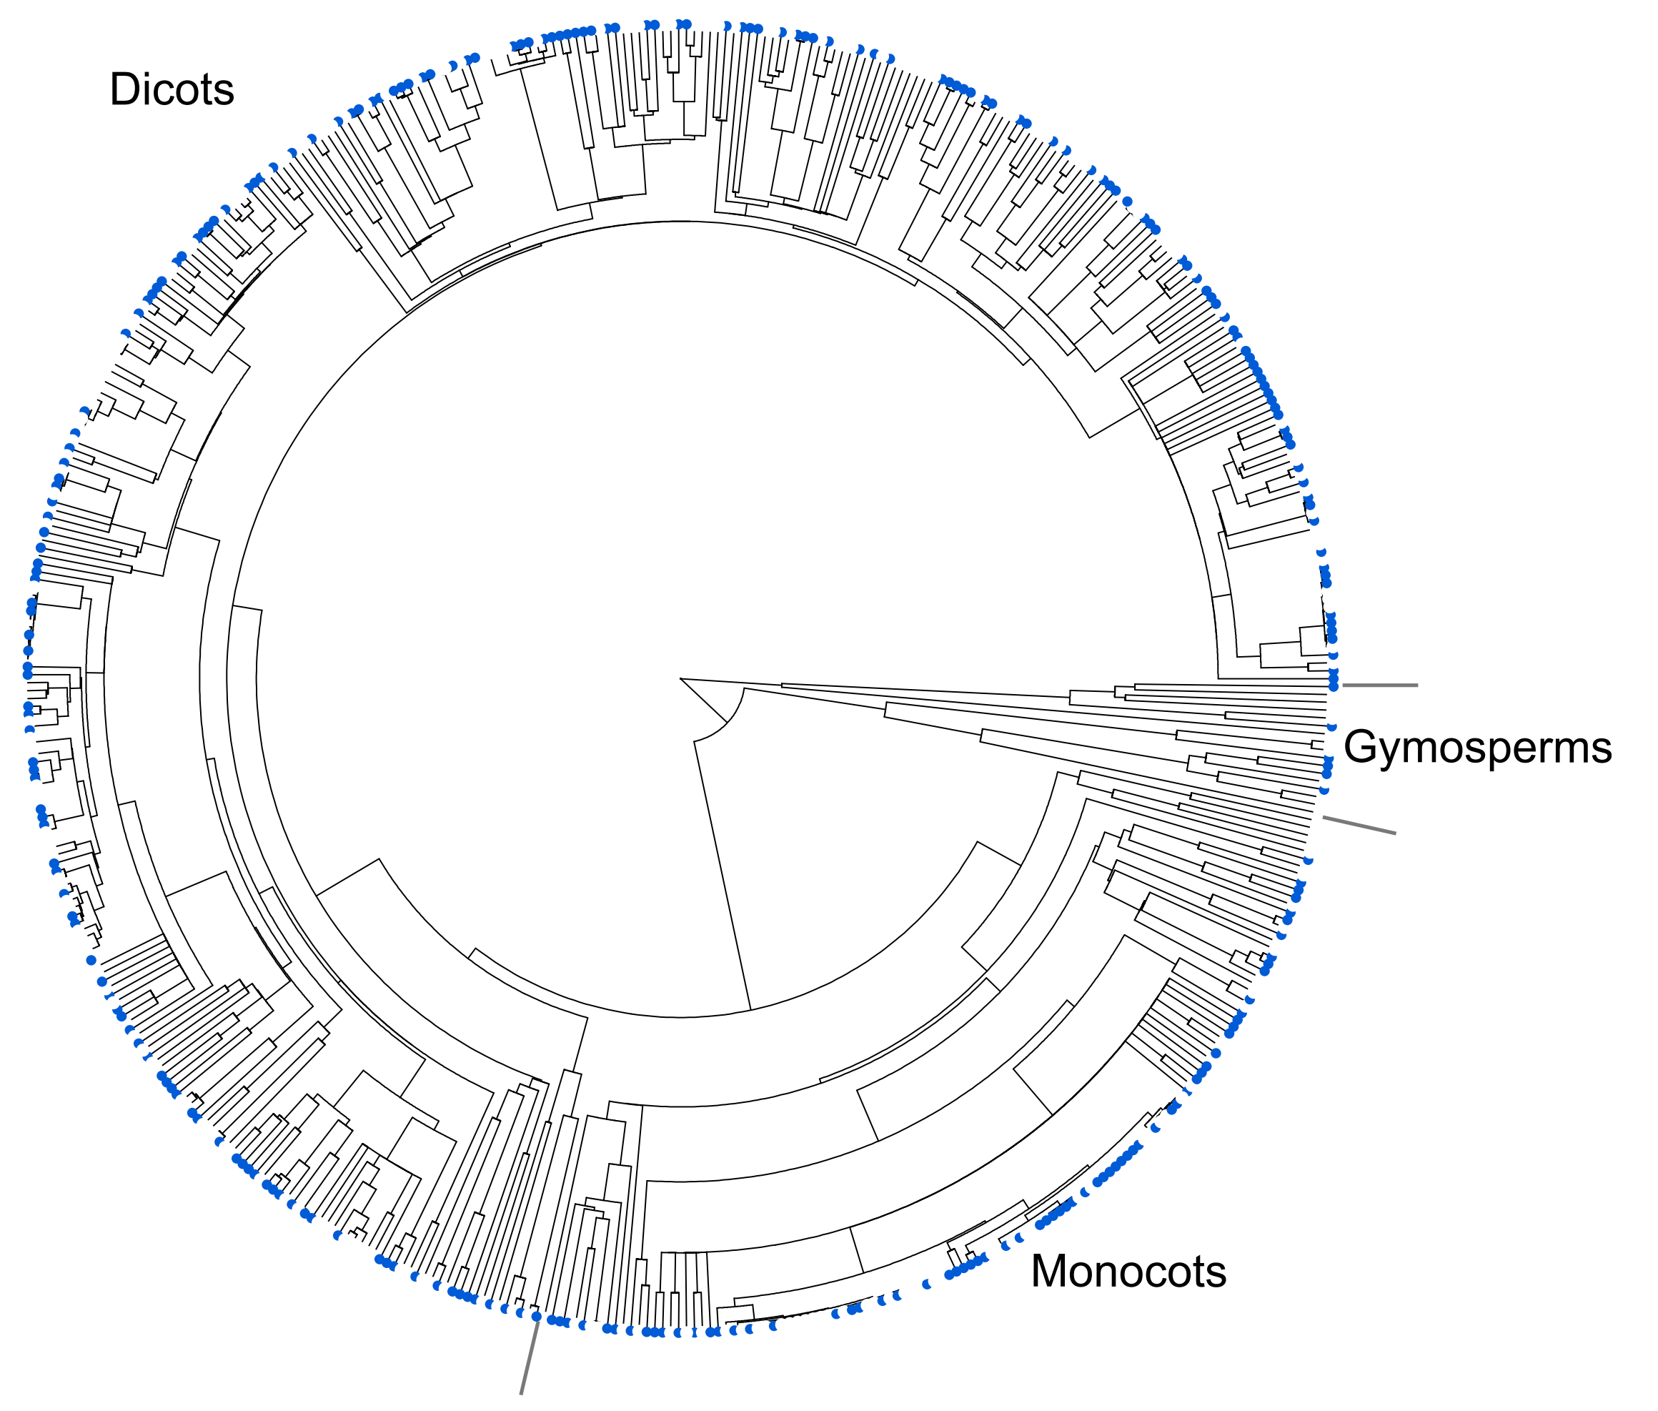
Allelopathy is common among invasive plant species
72% of surveyed invasive species
(n=526 species) had allelopathic
capabilities!
allelopathic invasive species
non-allelopathic invasive species
Kalisz et al. (2021) Biological Invasions
Notes:
Allelopathy is a secondary compound released through root exudation or leaf litter that negatively affects neighboring plant communities

Slide 4
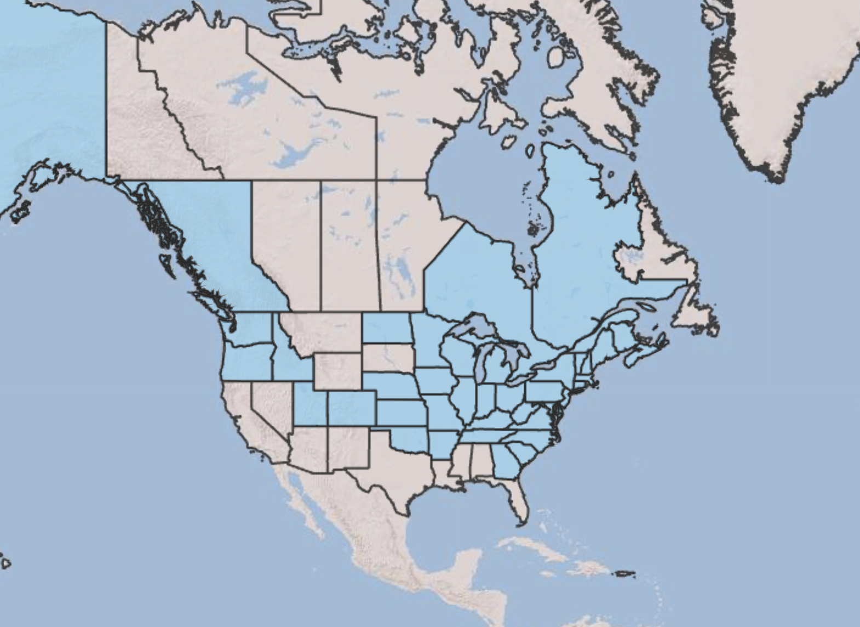
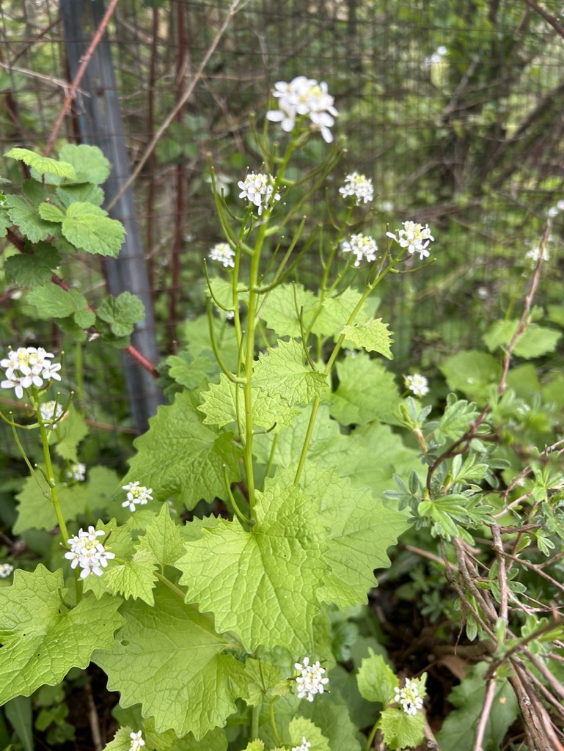
Garlic mustard (Alliaria petiolata, Brassicaceae) is a widespread allelopathic invader in North America
Aggressively invades understories of forests in the eastern half of North America
Biennial herb with two life forms
Non-mycorrhizal (acquires nutrients exclusively through direct root uptake)
Seedlings establish much earlier than coexisting native species
USDA Plants Database
Notes:
One common and well-studied model species for studying effects of allelopathic plant invasion on coexisting native species is garlic mustard

Slide 5
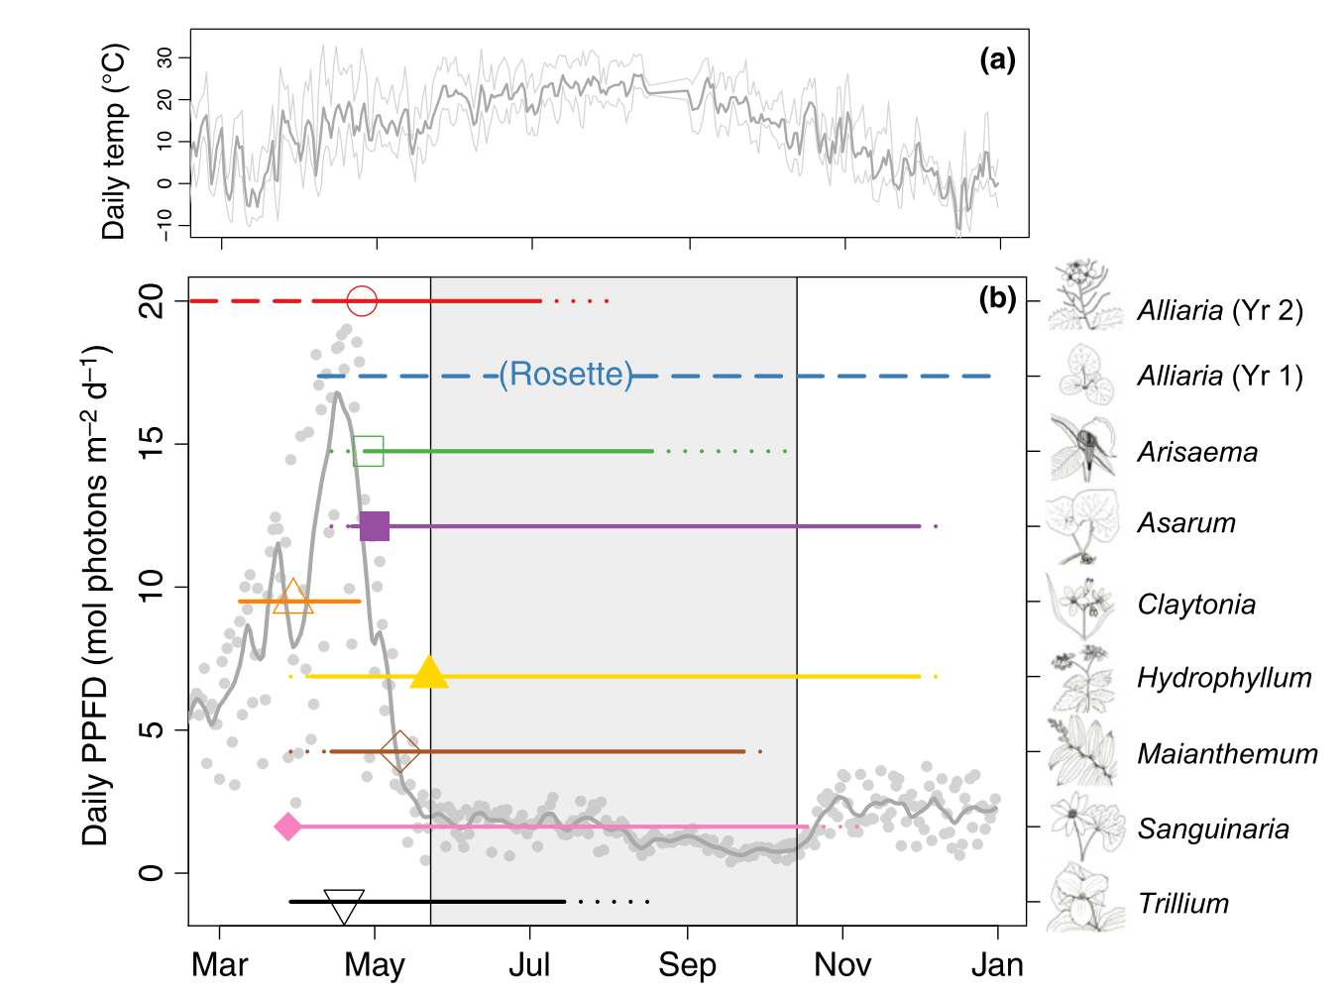
Garlic mustard (Alliaria petiolata, Brassicaceae) is a widespread allelopathic invader in North America
Aggressively invades understories of forests in the eastern half of North America
Biennial herb with two life forms
Non-mycorrhizal (acquires nutrients exclusively through direct root uptake)
Seedlings establish much earlier than coexisting native species
Heberling et al. (2019) New Phytologist

Slide 6
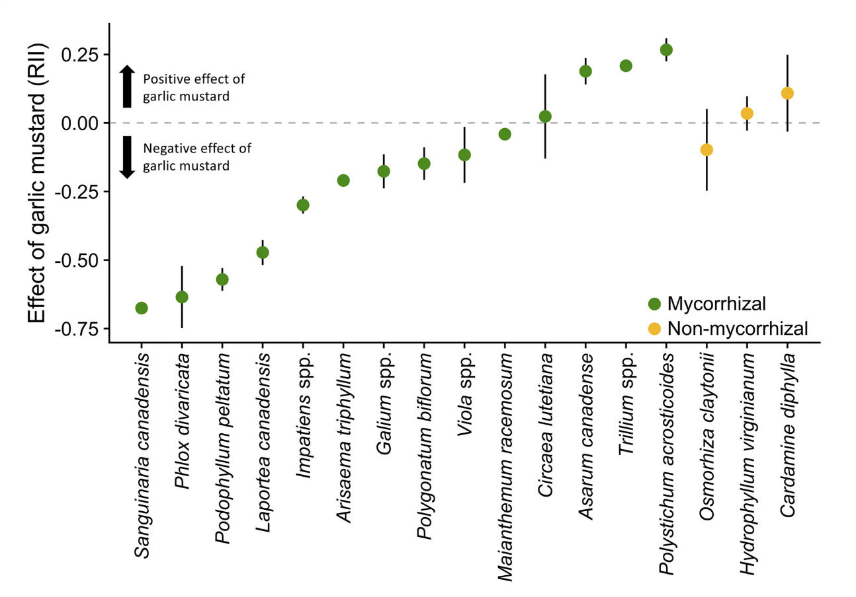
Garlic mustard presence generally decreases native species abundance
Native species that form
associations with AM fungi
respond to garlic mustard
presence by decreasing abundance
Roche et al. (2021) Ecology

Slide 7
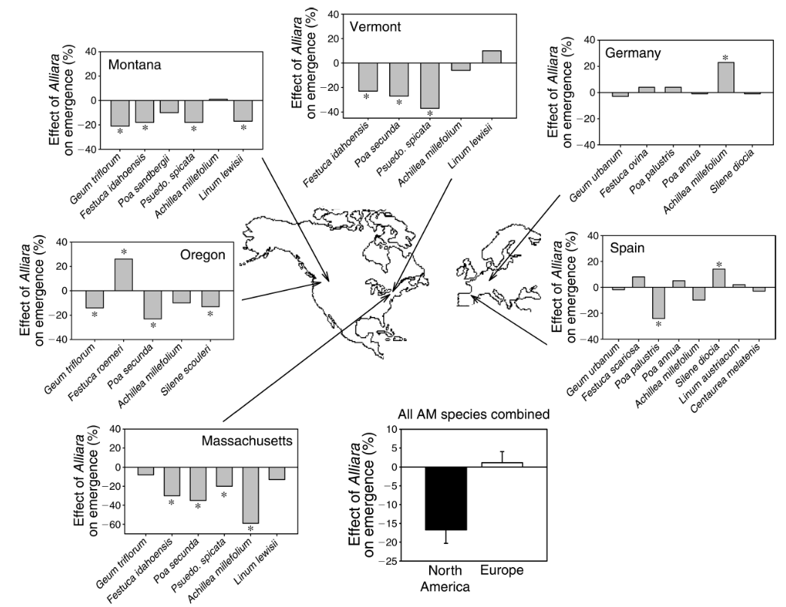
Garlic mustard decreases emergence rates of coexisting plants in its non-native range
non-native
range
Callaway et al. (2008) Ecology

Slide 8
Garlic mustard decreases emergence rates of coexisting plants in its non-native range
non-native
range
Callaway et al. (2008) Ecology

Slide 9
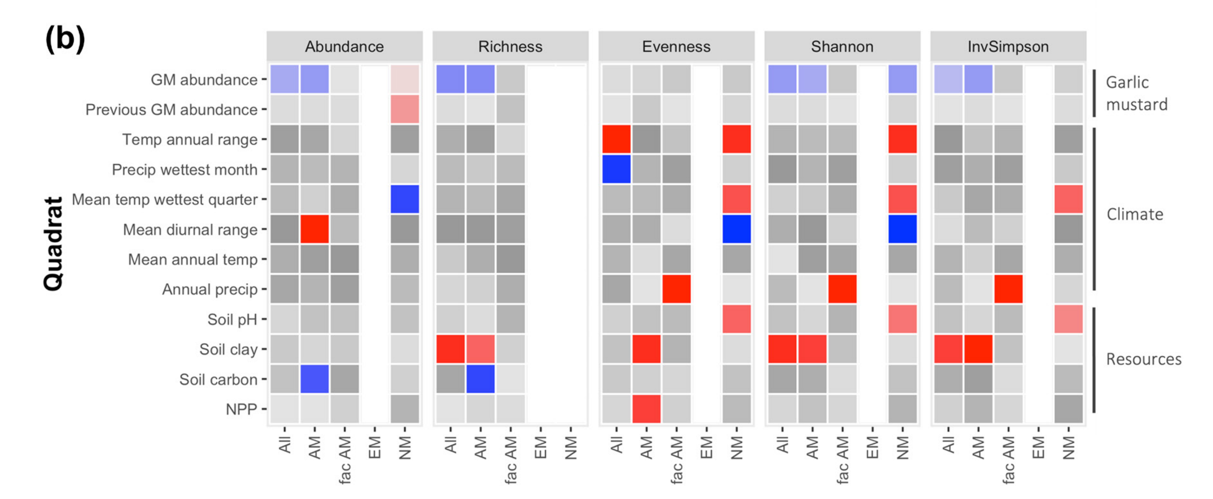
Garlic mustard invasion intensity negatively affects indices of community diversity
Blue = negative effect
Red = positive effect
Roche et al. (2023) Ecography
Notes:
Negative effects of garlic mustard on species abundance, richness, and diversity indices are driven by strong negative effects of garlic mustard on species that form associations with arbuscular mycorrhizal fungi
Ok we see these population and community level responses to garlic mustard and that these responses are generally more pronounced in AM-associating species, but why?
What is the mechanism?

Slide 10
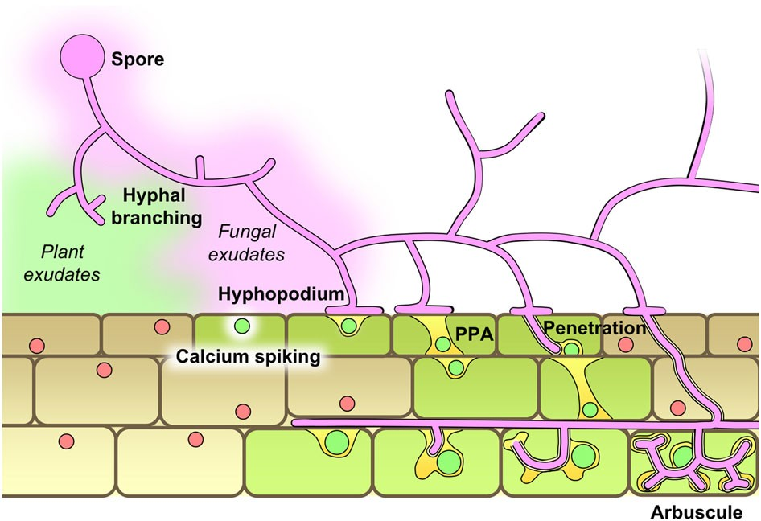
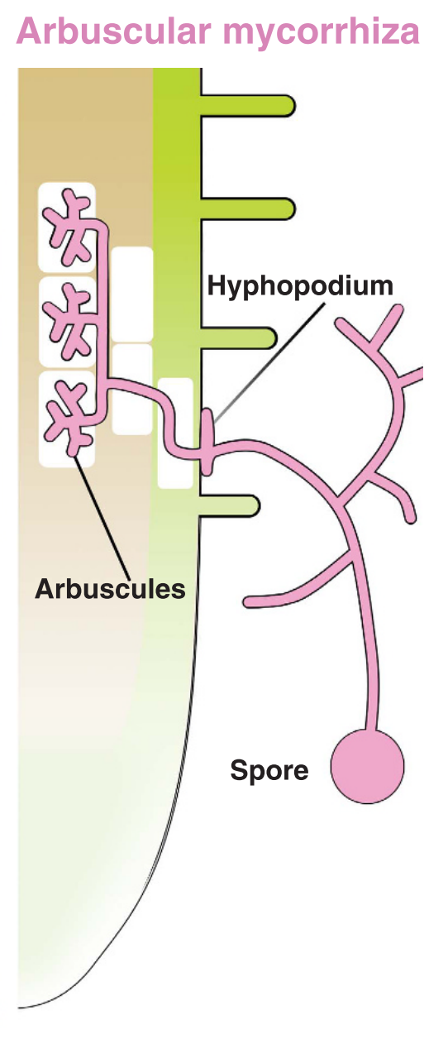
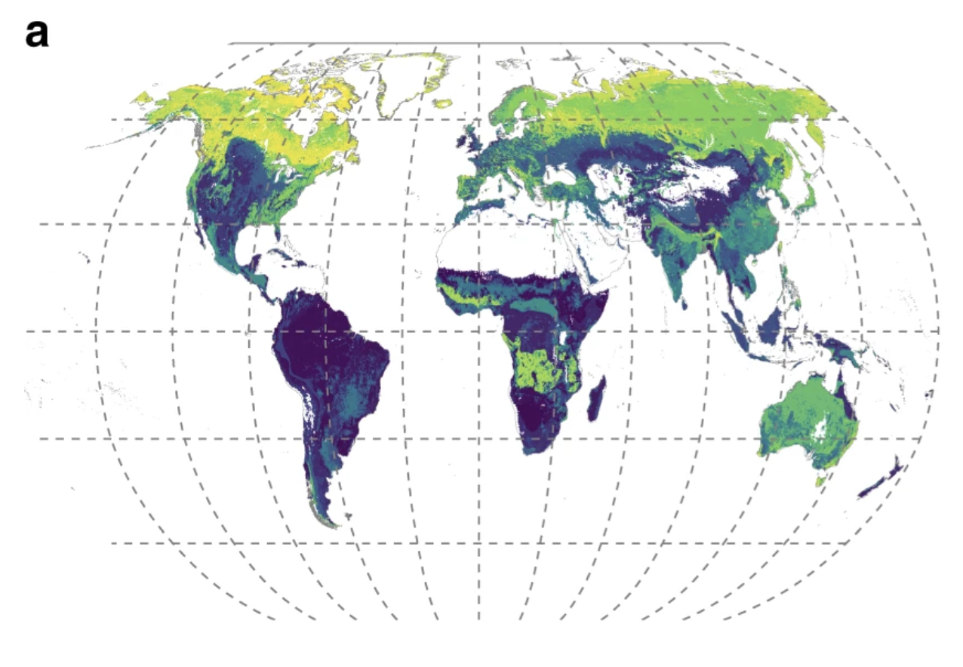
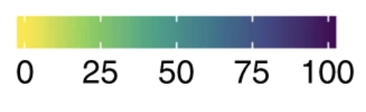
Plant-AM fungal symbioses
Form mostly obligate relationships with plant roots
~72% of land plants associate with AM fungi
Carbon-for nutrient exchange
Hyphae explore soil solution for mineral nutrients (N and P)
Mined nutrients exchanged for plant sugars directly within plant root cells
Percentage of AM-associated
aboveground plant biomass
Bonfante & Genre (2010) Nature Communications; Soudzilovskaia et al. (2015) Nature Communications
Notes:
Ordovician
Plants provision 20-40% of sugars recently produced through photosynthesis to AM fungi
AM fungi provide 70-100% of the plants’ phosphorus acquisition and up to 50% of the plants’ nitrogen acquisition

Slide 11
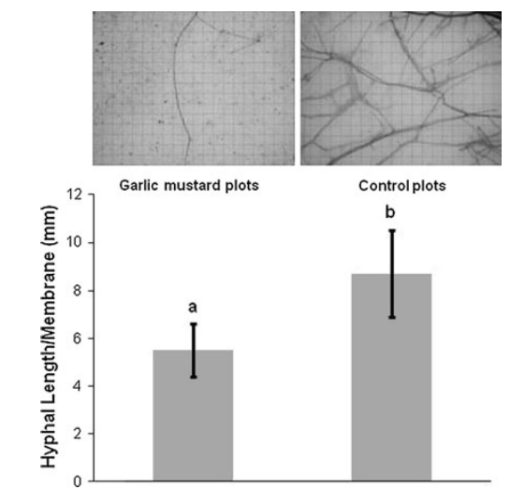
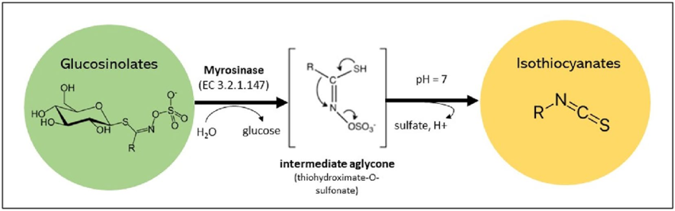
Antimicrobial compounds produced by garlic mustard change AM fungal community function
Isothiocyanates kill AM spores and reduce AM root colonization, hyphal growth, and arbuscule formation
Cantor et al. (2011) Biological Invasions

Slide 12
… which may alter the method through which a plant acquires nutrients and water
Roche et al. (2021) Ecology
Bonfante & Genre (2010) Nature Communications
Notes:
Note that all mycorrhizal species here form associations with arbuscular mycorrhizal fungi

Slide 13
… which may alter the method through which a plant acquires nutrients and water
X
X
X
X
Roche et al. (2021) Ecology
Bonfante & Genre (2010) Nature Communications
Notes:
Disruptions in fungal spore germination and hyphal branching could jeopardize the strength of a plant-AM symbioses
This could cause individuals to shift nutrient uptake to direct uptake methods, sharing niche space with garlic mustard
Garlic mustard emerges earlier than coexisting native species

Slide 14
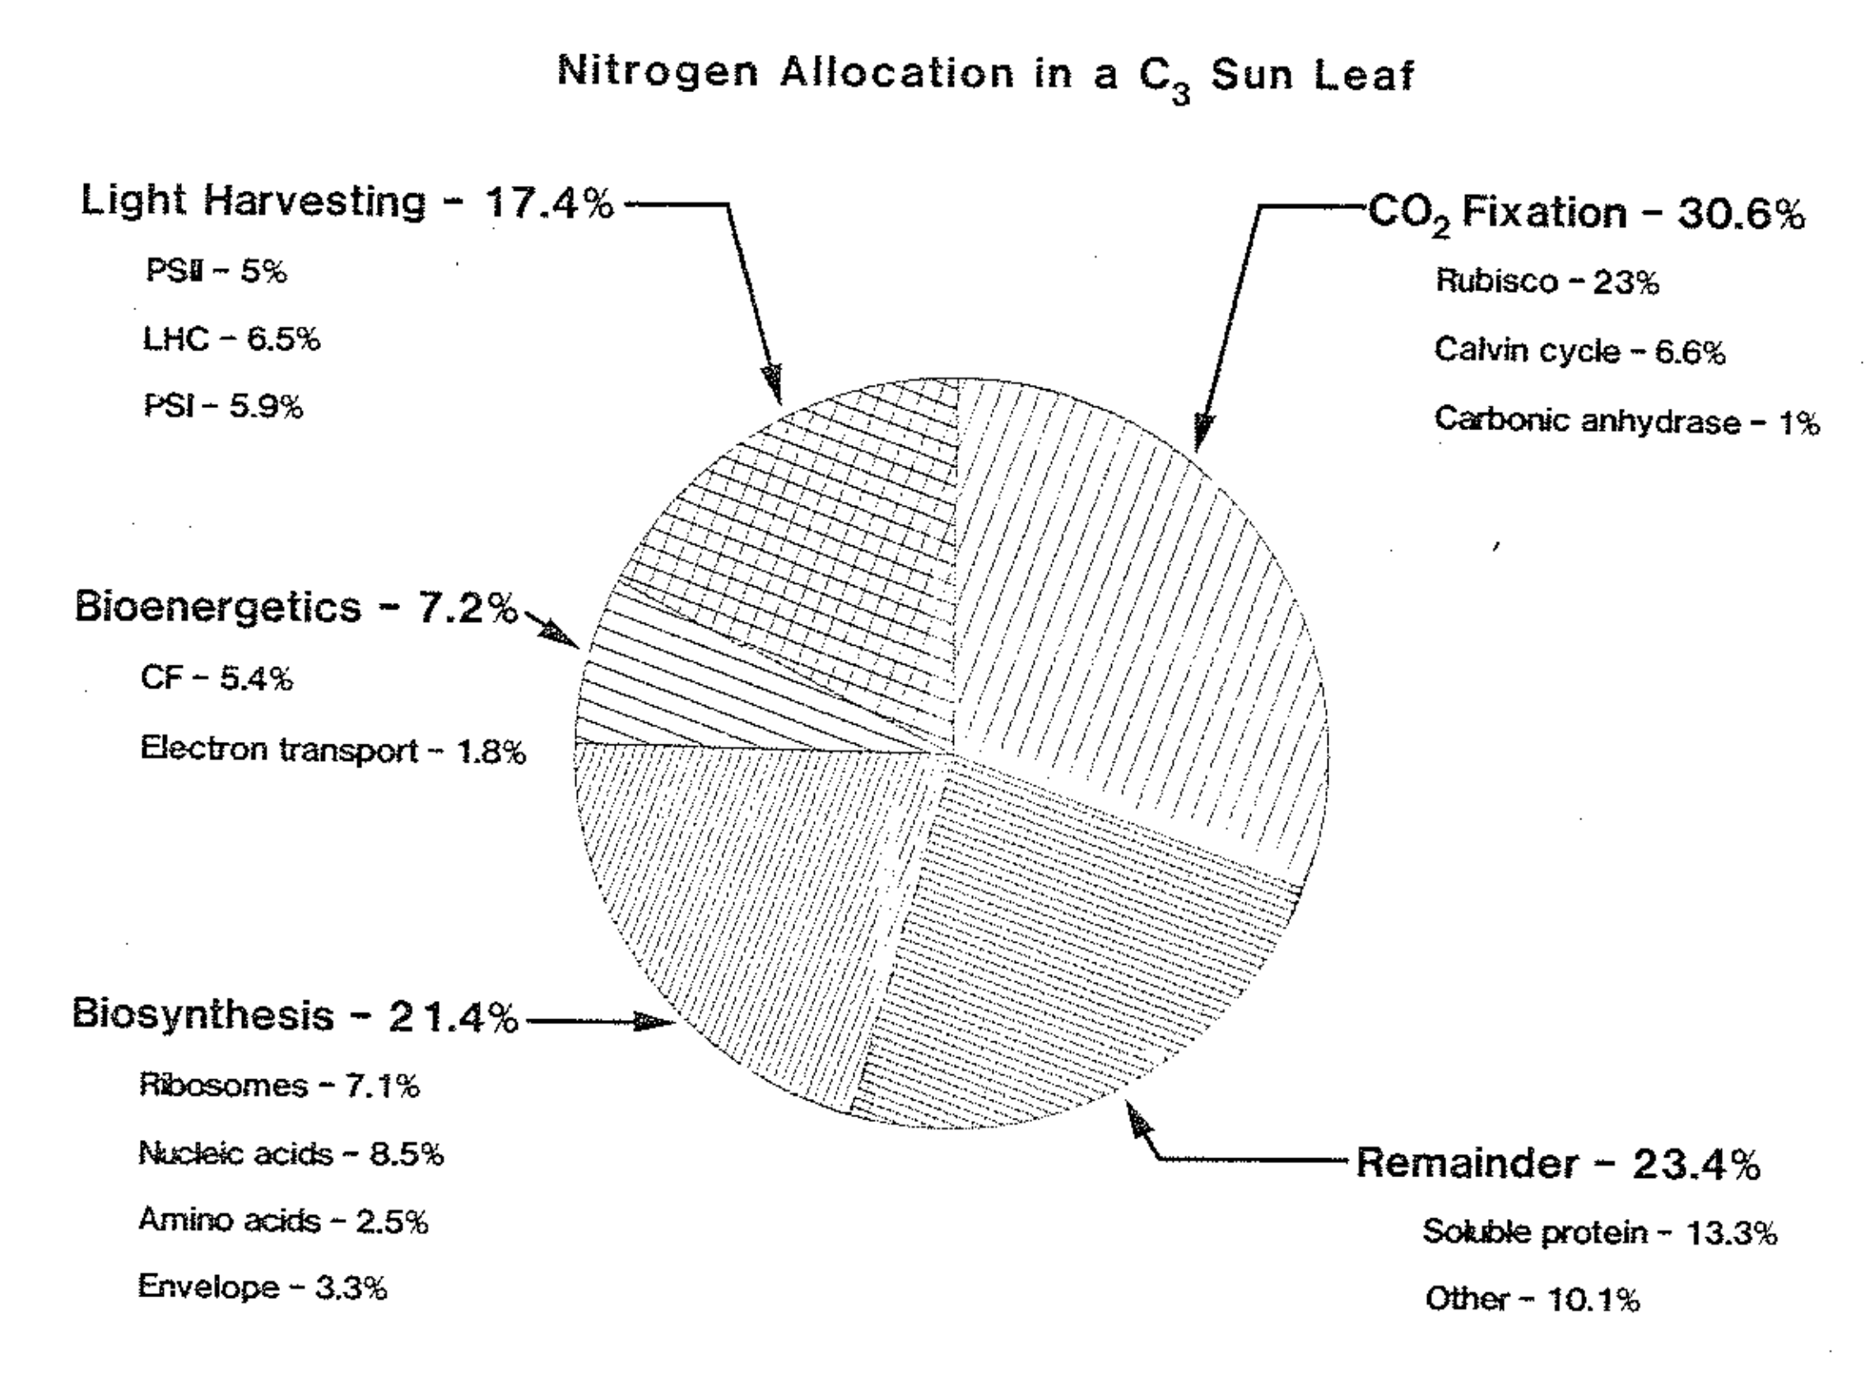
Antimicrobial effects of garlic mustard invasion may negatively impact native species photosynthesis, as photosynthetic enzymes are nitrogen-rich
Evans & Seemann (1989) Photosynthesis
Notes:
It is therefore logical to expect that the deleterious effects of garlic mustard on mycorrhizal communities may scale to negatively impact leaf-level photosynthesis
This is because it is nutritionally expensive to build and maintain photosynthetic enzymes, and any disruption in nutrient uptake would presumably alter investment in photosynthetic tissues..

Slide 15
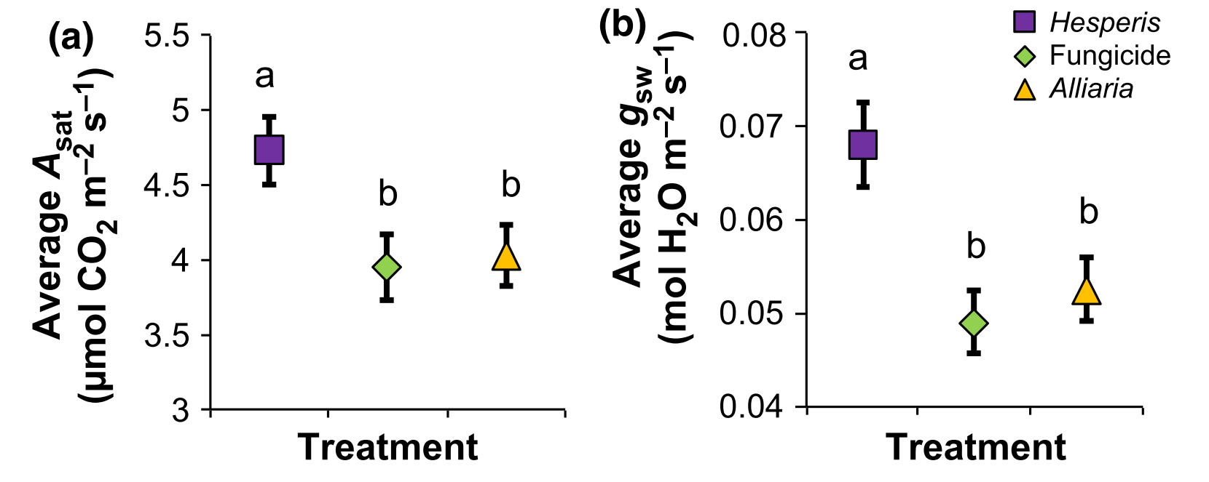
Indeed, garlic mustard decreases snapshot gas exchange of coexisting native species
Hale et al. (2016) New Phytologist

Slide 16
Indeed, garlic mustard decreases snapshot gas exchange of coexisting native species
leaf litter of non-allelopathic
invader
simulates effects of
allelopathic invader
leaf litter of allelopathic
invader
Hale et al. (2016) New Phytologist
Notes:
Snapshot measurements do little to tell us about mechanisms driving these responses
Notably, these measurements were recorded after the tree canopy had closed and soil resource availability had depleted,
so these responses have only been observed through a narrow temporal lens

Slide 17
Indeed, garlic mustard decreases snapshot gas exchange of coexisting native species
leaf litter of non-allelopathic
invader
simulates effects of
allelopathic invader
leaf litter of allelopathic
invader
What are the mechanisms that drive these responses?
How do these responses vary due to seasonality (e.g., tree canopy closure)?
Hale et al. (2016) New Phytologist

Slide 18
Major questions
How does garlic mustard presence influence leaf-level photosynthesis and the mechanisms that determine these responses in coexisting native species?
Do the effects of garlic mustard presence on leaf-level photosynthesis vary due to seasonality?
Tree canopy status (closes as growth season progresses)
Resource availability (decreases as growth season progresses)

Slide 19
Hypotheses
Photosynthetic capacity
Leaf-level carbon assimilation
Stomatal conductance
Predicted positive effect
Predicted negative effect

Slide 20
Hypotheses
Photosynthetic capacity
Garlic mustard presence
Leaf-level carbon assimilation
Stomatal conductance
Predicted positive effect
Predicted negative effect

Slide 21
Hypotheses
Negative effects of garlic mustard may be strongest early in growth season
when demand to build and
maintain photosynthetic
enzymes are high
Photosynthetic capacity
Garlic mustard presence
Leaf-level carbon assimilation
Stomatal conductance
Predicted positive effect
Predicted negative effect

Slide 22
Hypotheses
Negative effects of garlic mustard may be strongest early in growth season
when demand to build and
maintain photosynthetic
enzymes are high
Photosynthetic capacity
Garlic mustard presence
Leaf-level carbon assimilation
-or-
Negative effects of garlic mustard may be strongest later in growth season
when resource availability is depleted and reliance on AM fungal partners is greatest
Stomatal conductance
Predicted positive effect
Predicted negative effect

Slide 23
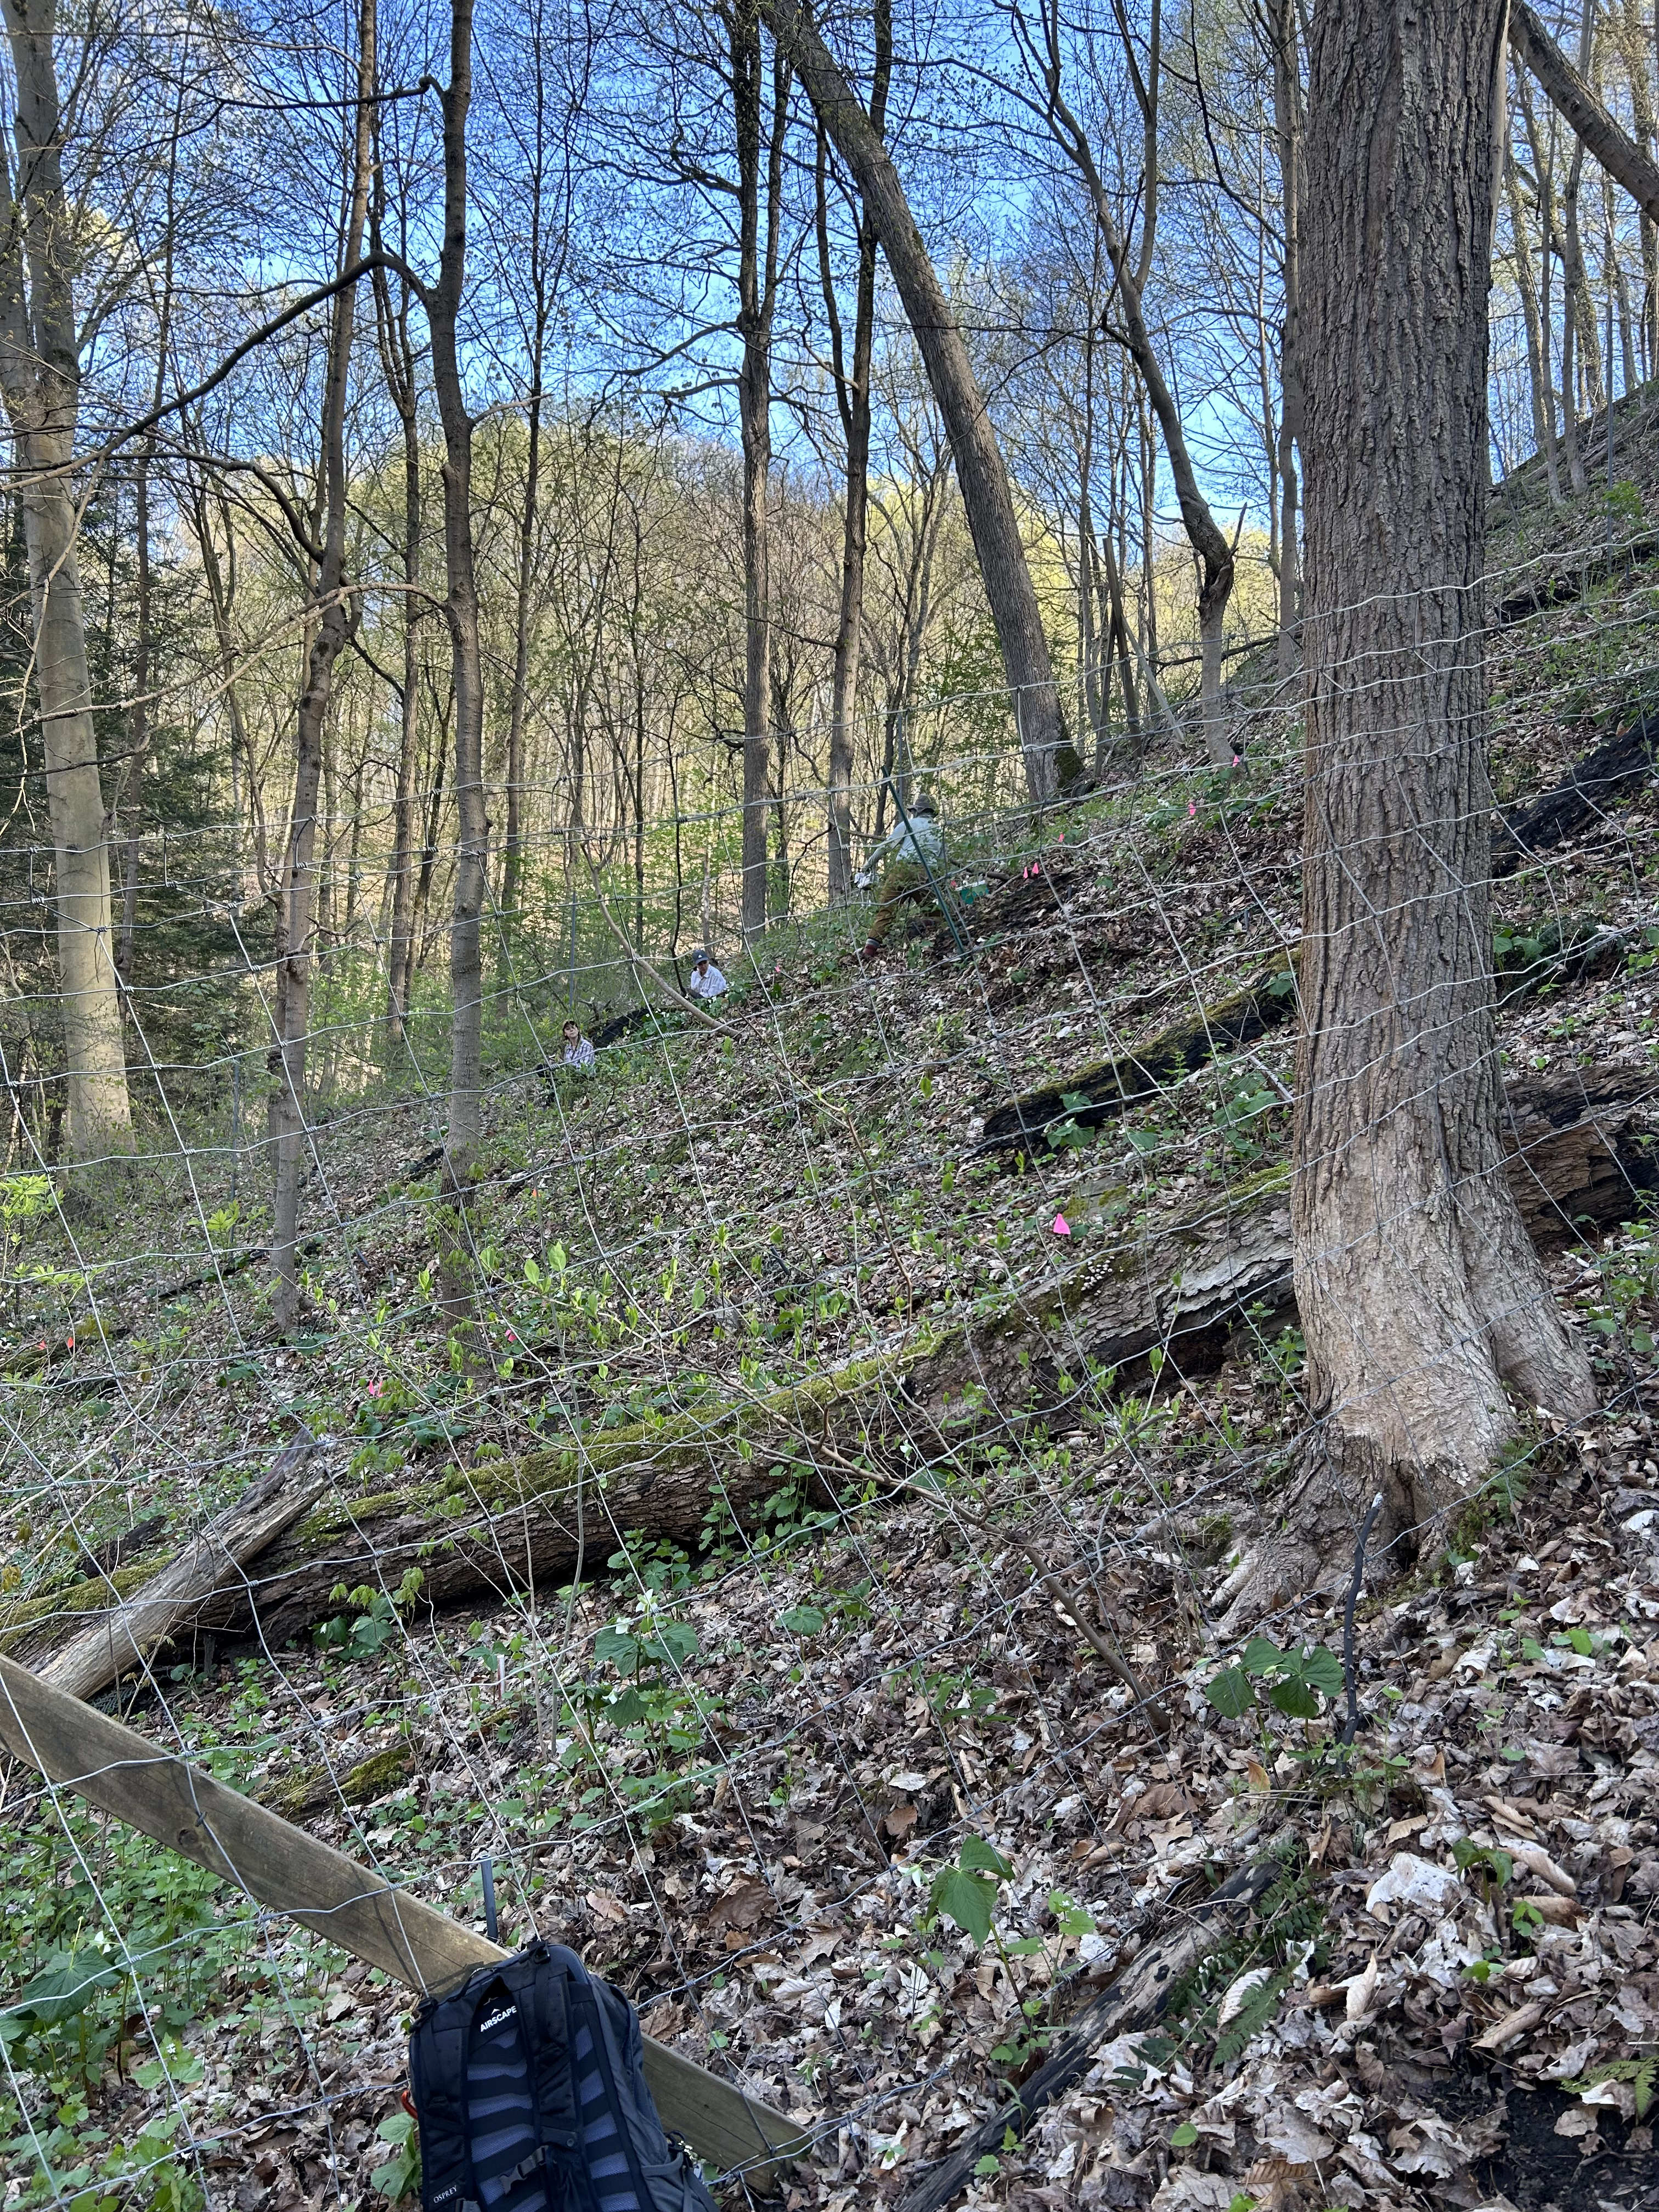
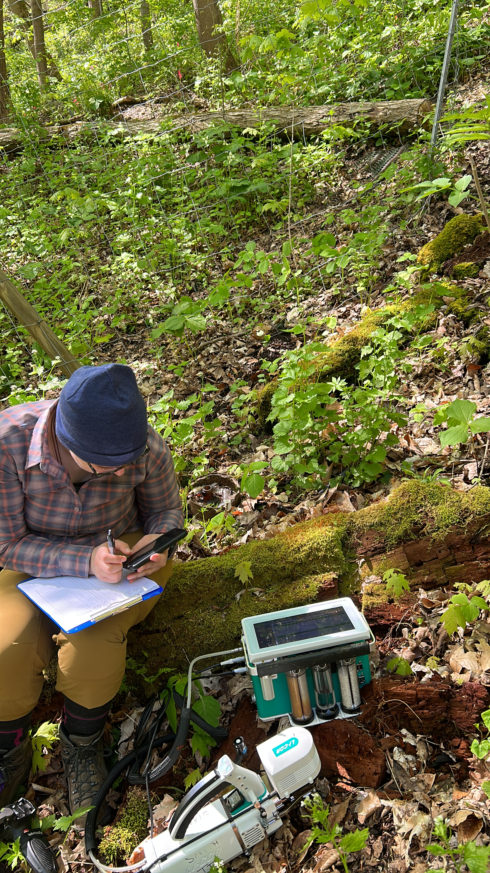
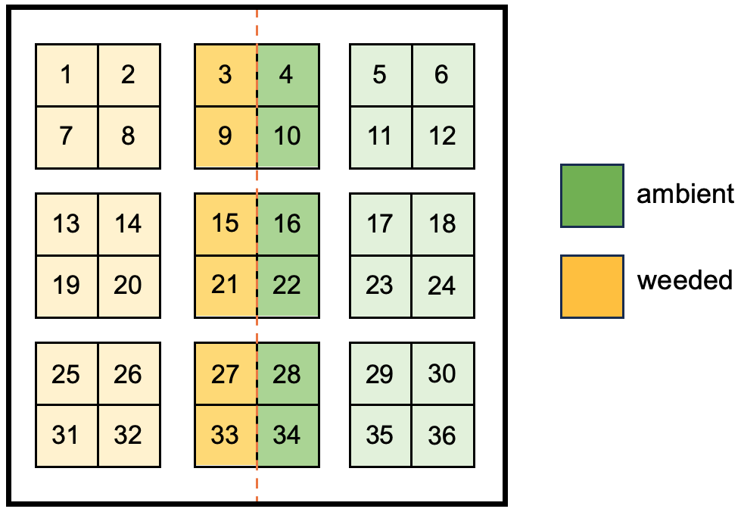
Experiment
Fencing established in 2002 to ward out deer/macro-herbivores
Manual garlic mustard weeding in half of each plot since 2006

Slide 24
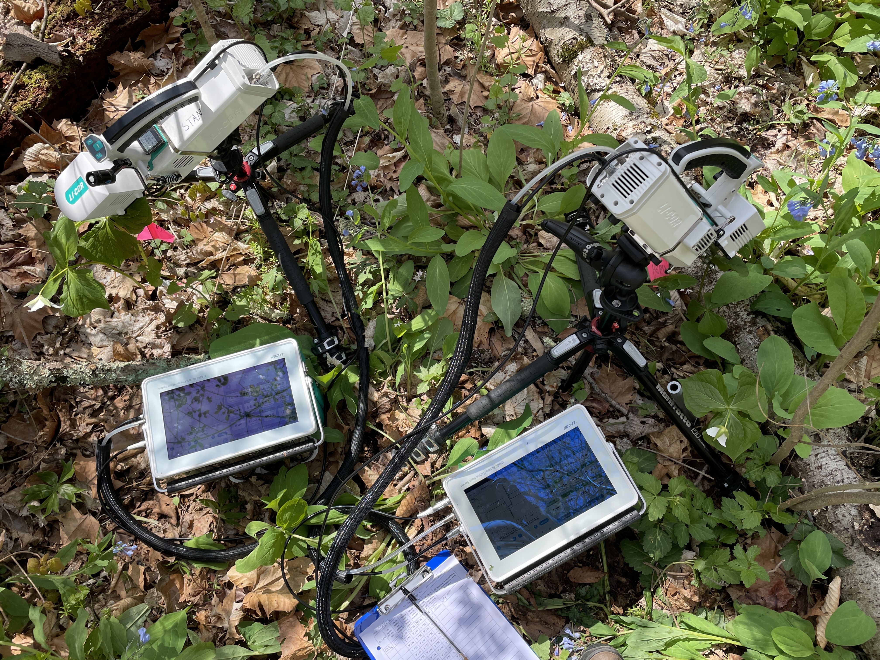
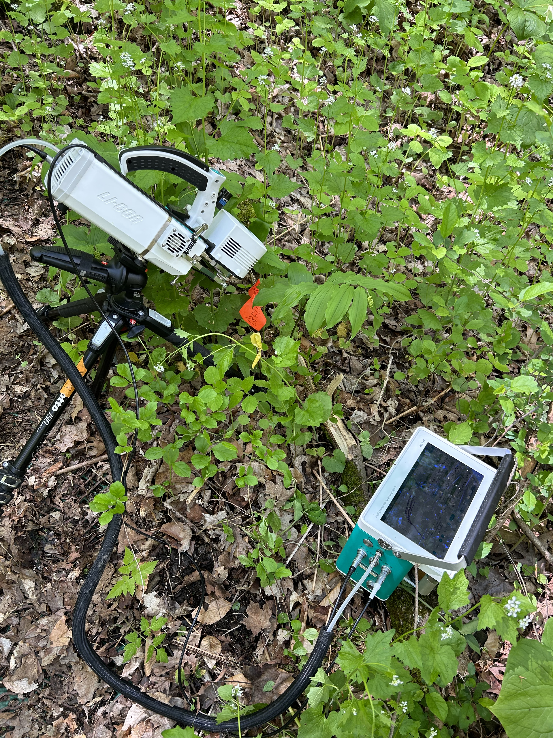
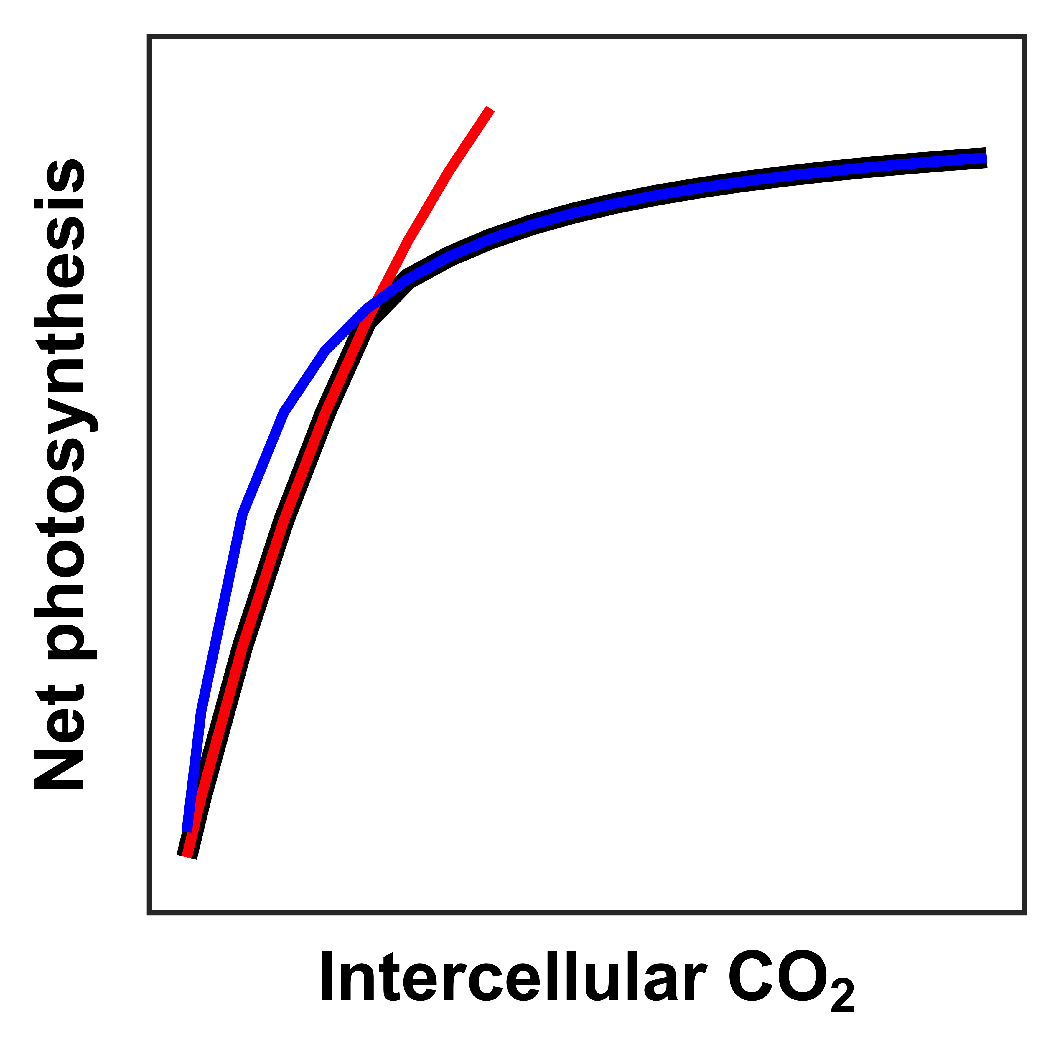
Field measurements
Soil resin sticks
Mobile ammonium, nitrate, and phosphate ions
CO₂ response curves
Maximum rate of Rubisco carboxylation (V_{cmax})
Maximum rate of electron transport for RuBP regeneration (J_{max})
Snapshot gas exchange measurements
x 2 measurement periods (open, closed tree canopy)

Slide 25
Heberling et al. (2019)
Trillium spp.
Maianthemum racemosum
second measurement period (closed tree canopy)
first measurement period (open tree canopy)

Slide 26
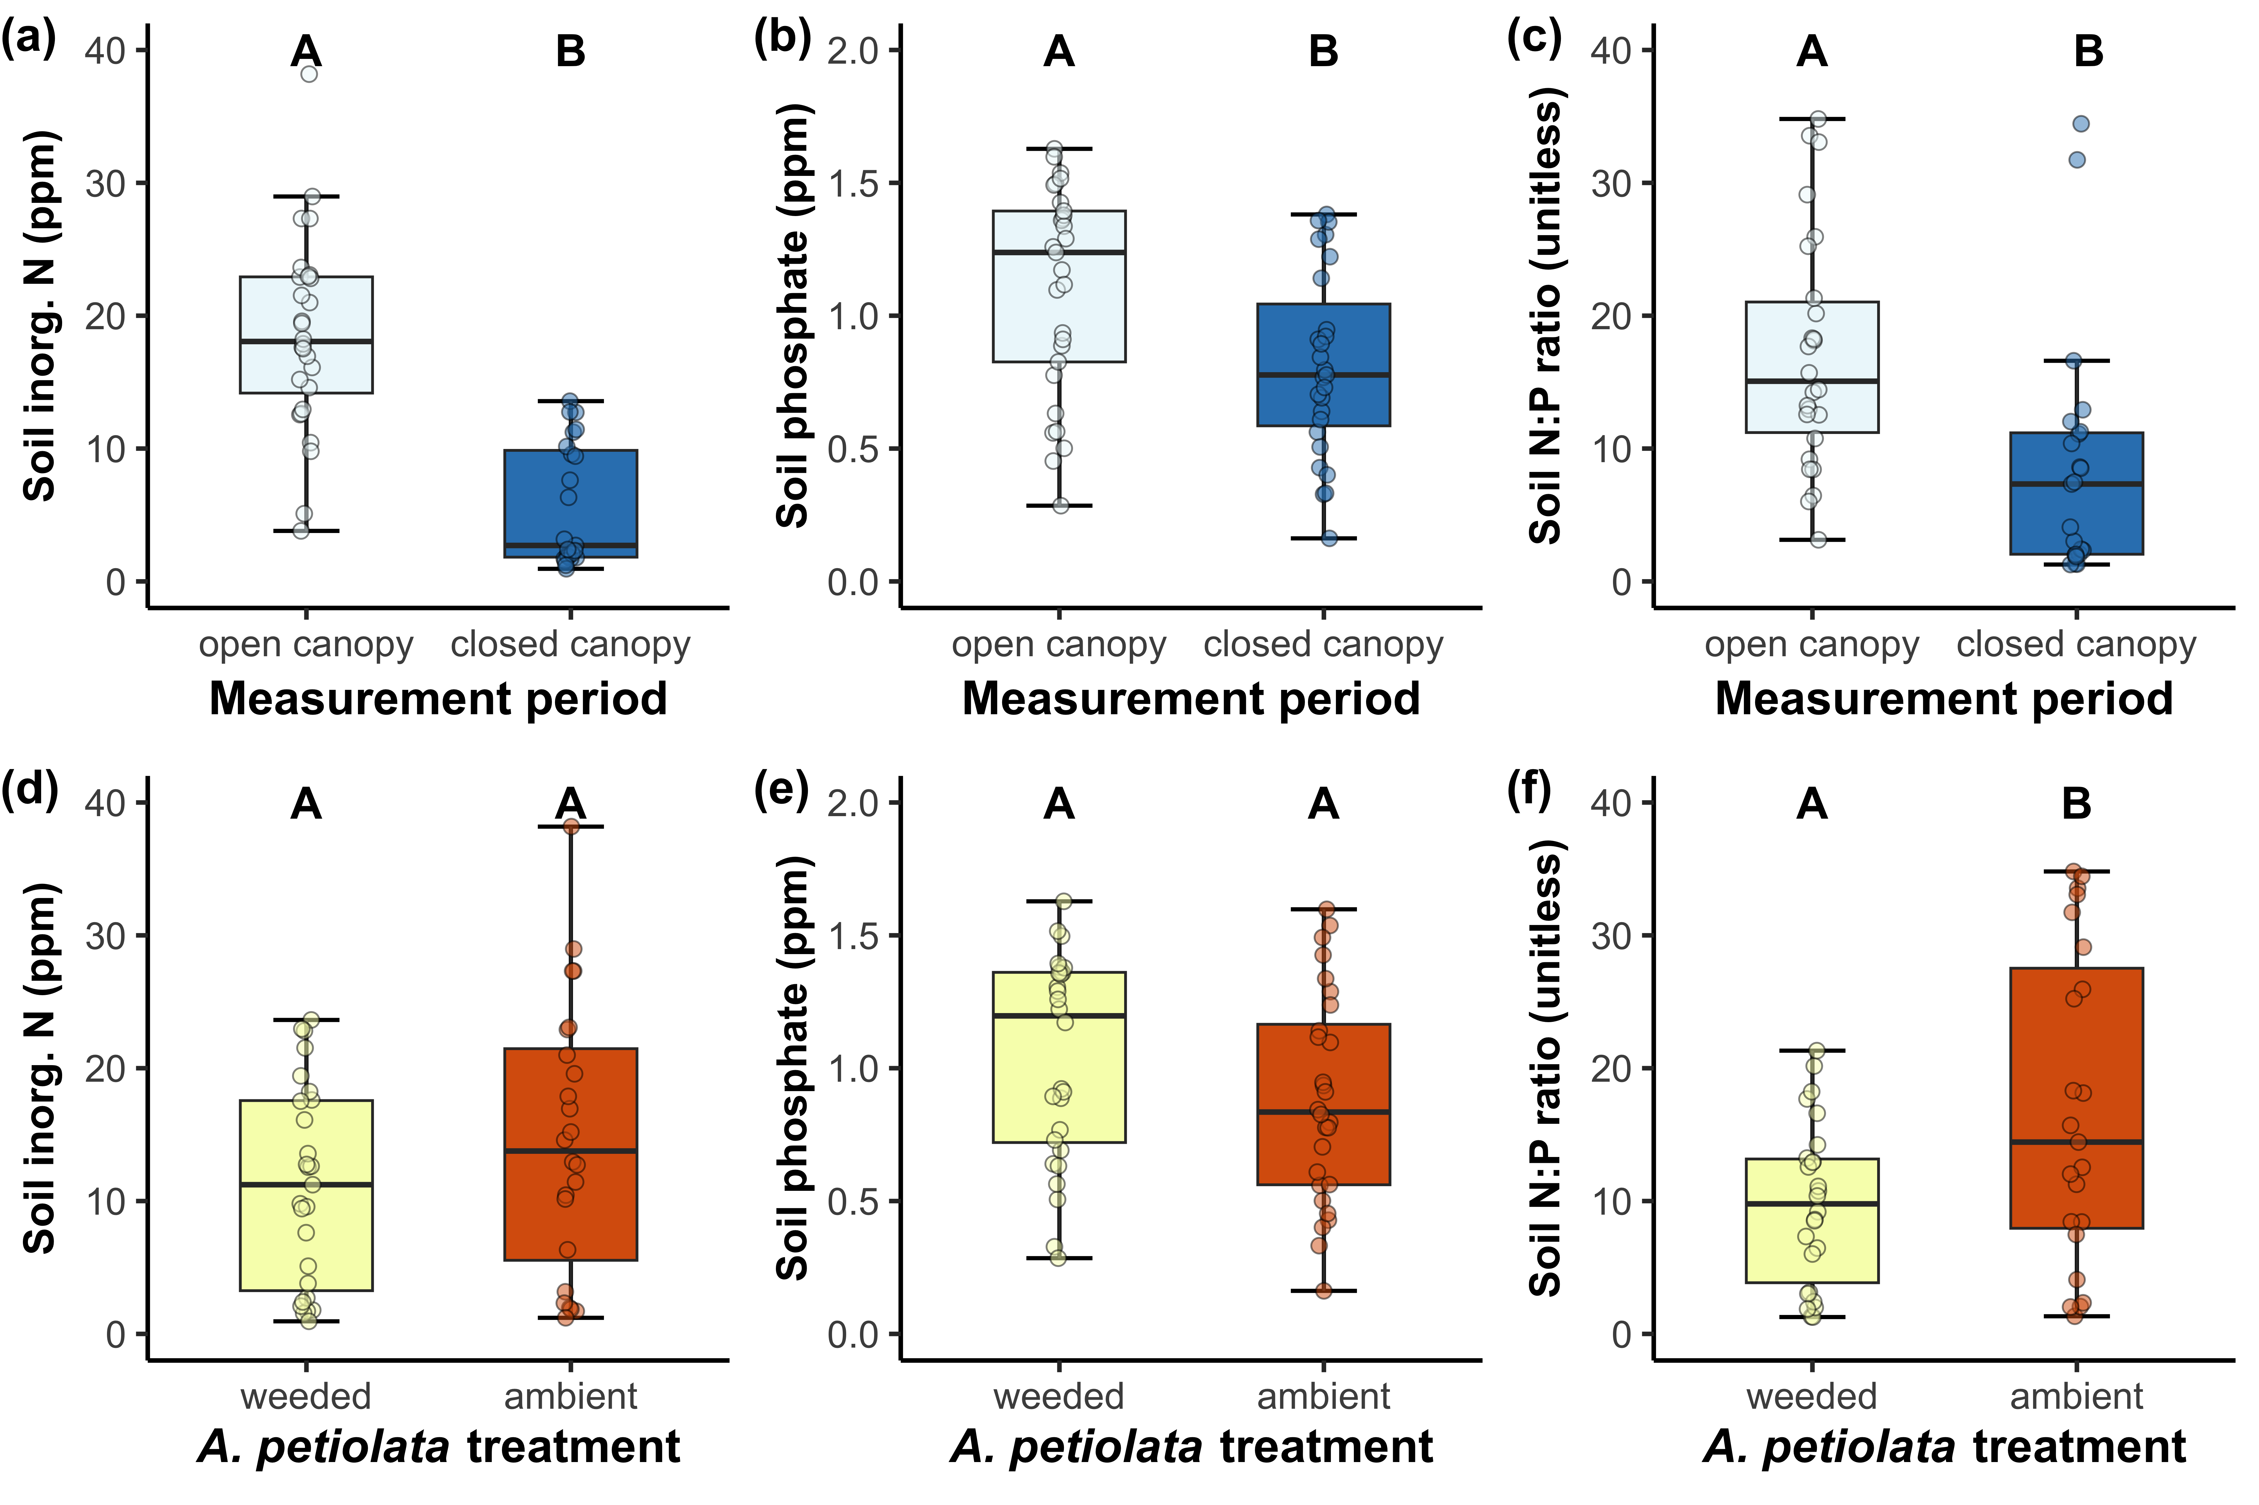
Soil nutrient availability decreased as the growth season progressed

Slide 27
Garlic mustard increased soil N:P, but not soil N or soil P

Slide 28
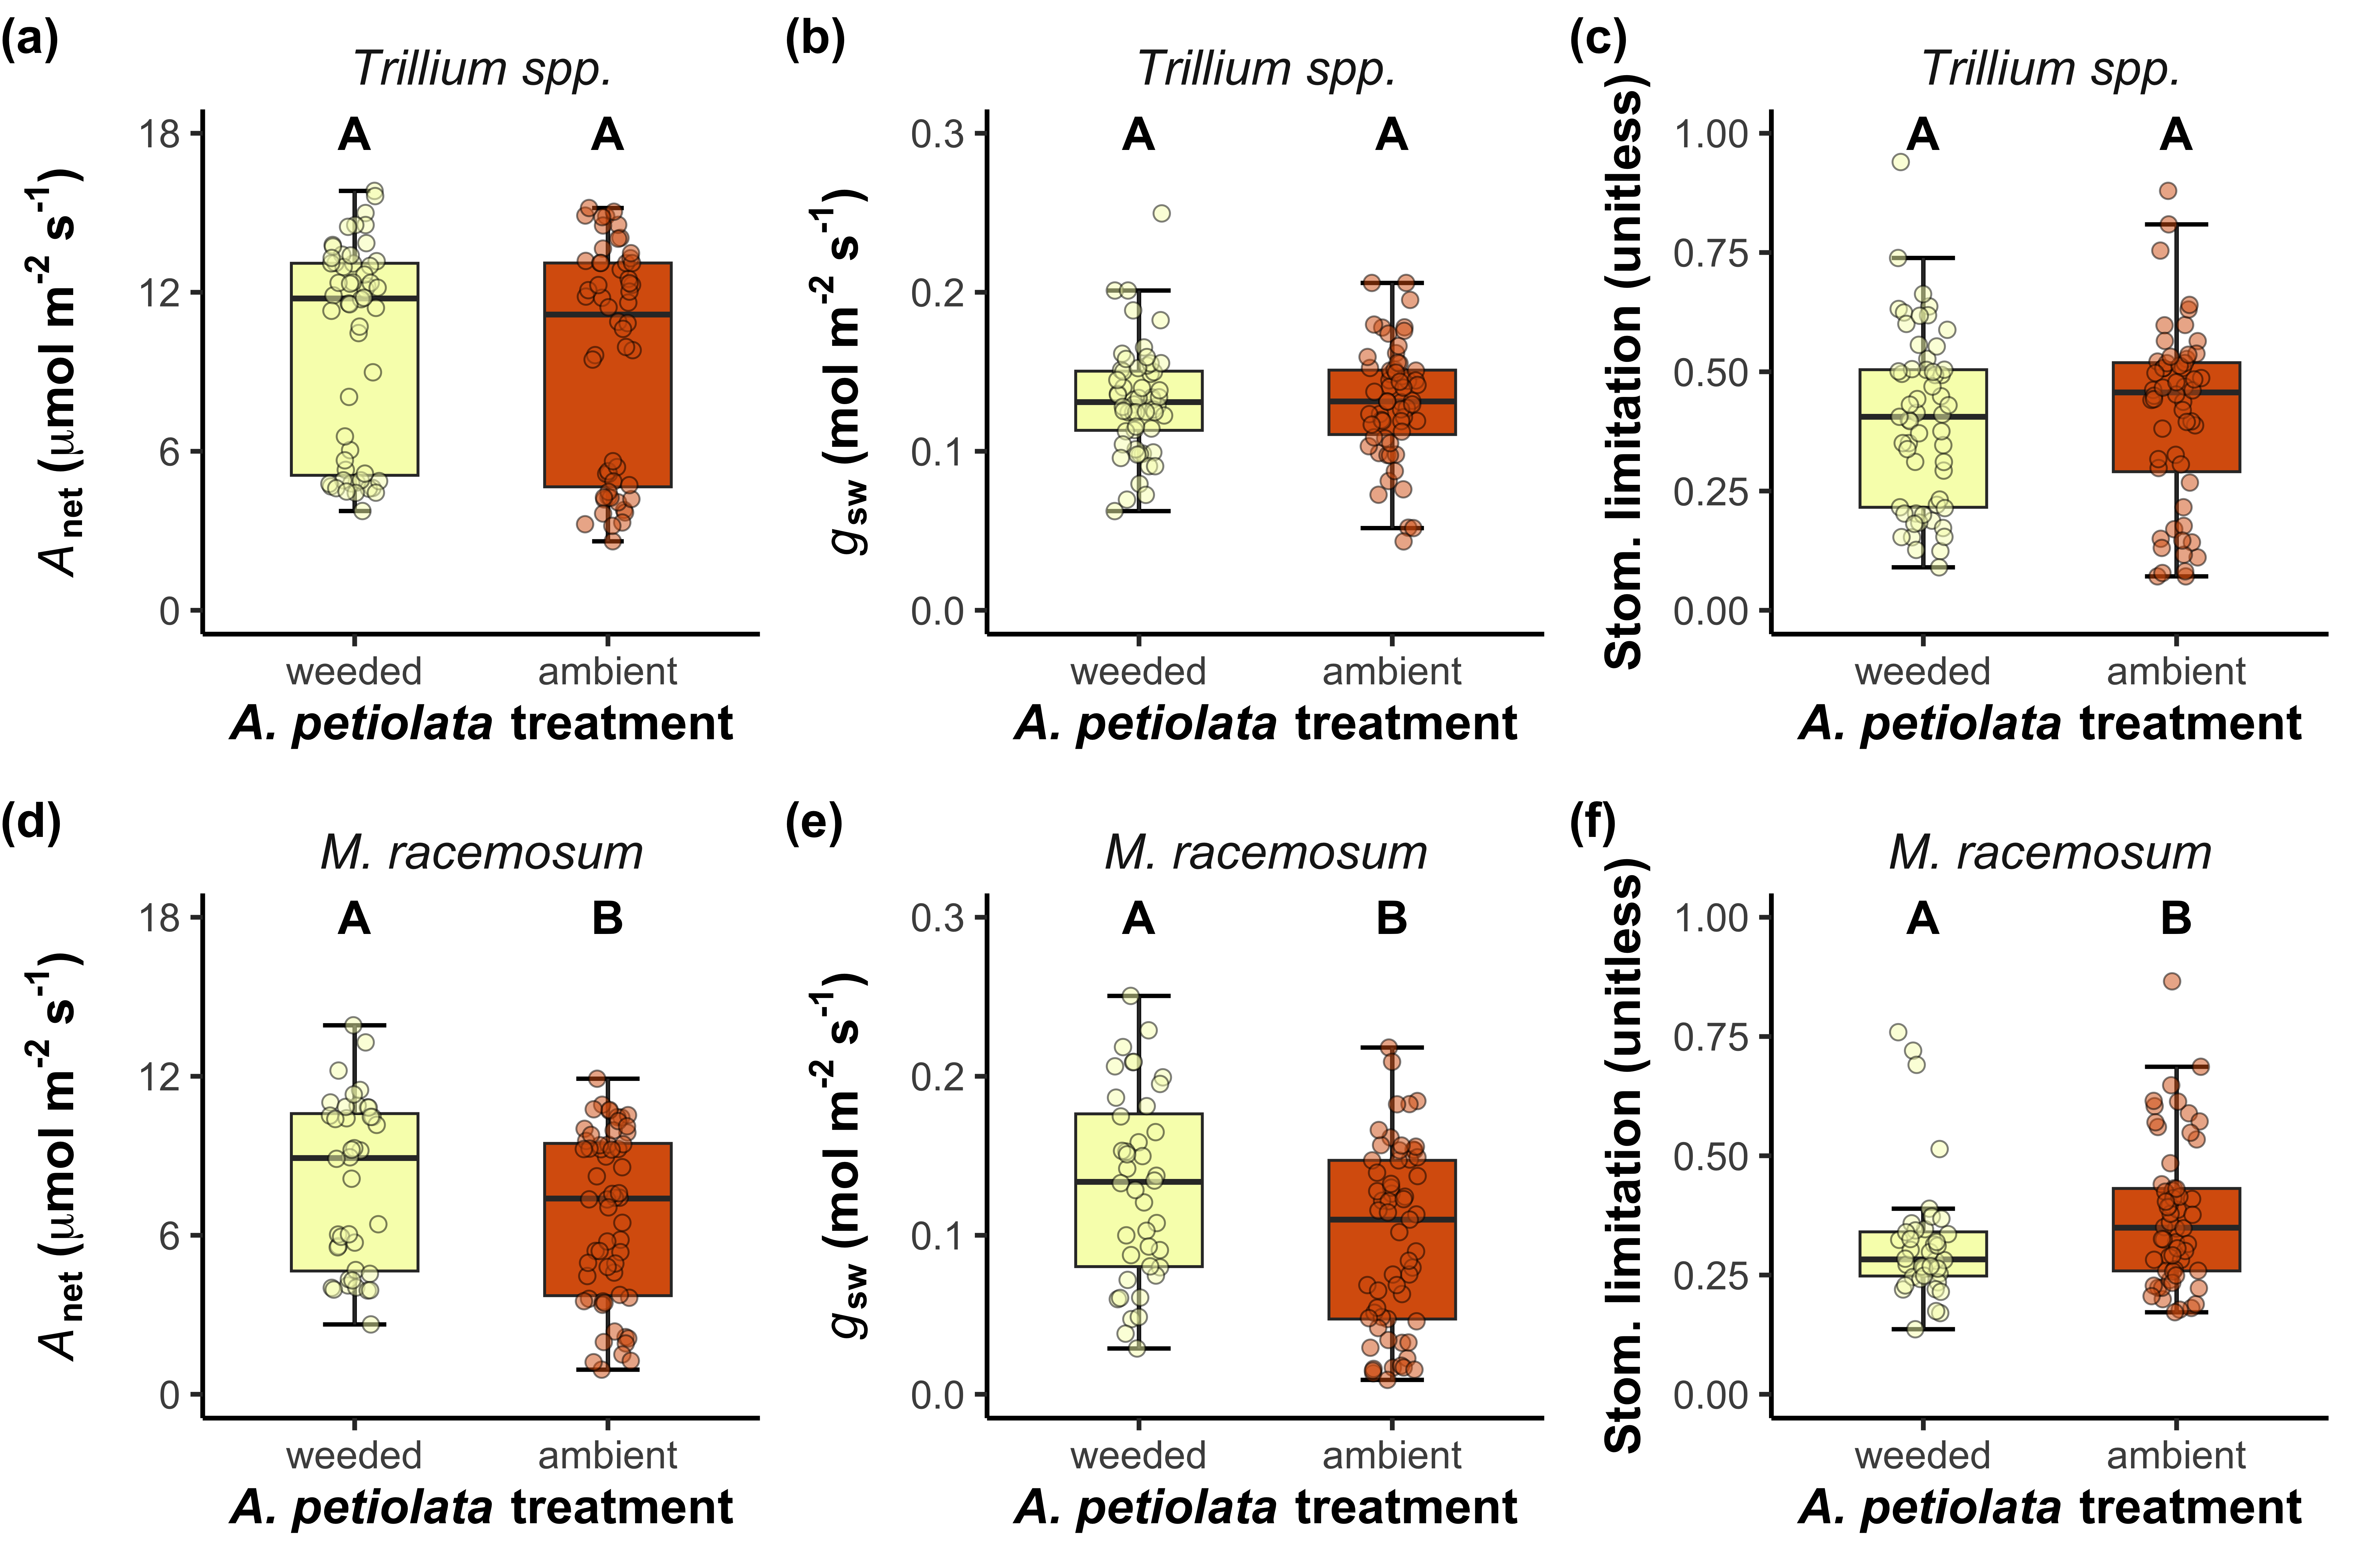
Garlic mustard presence has no effect on Trillium spp. net photosynthesis or stomatal conductance

Slide 29
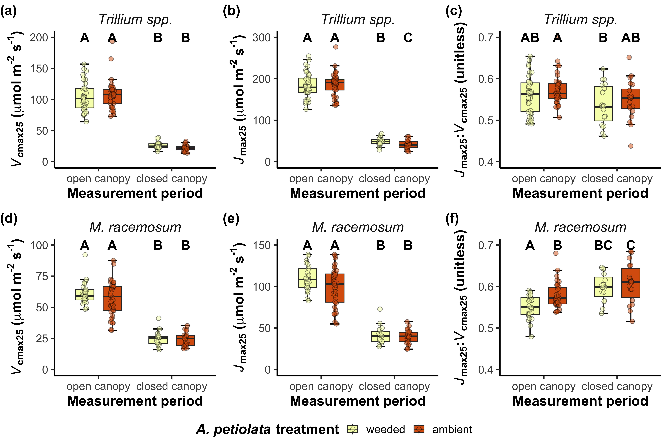
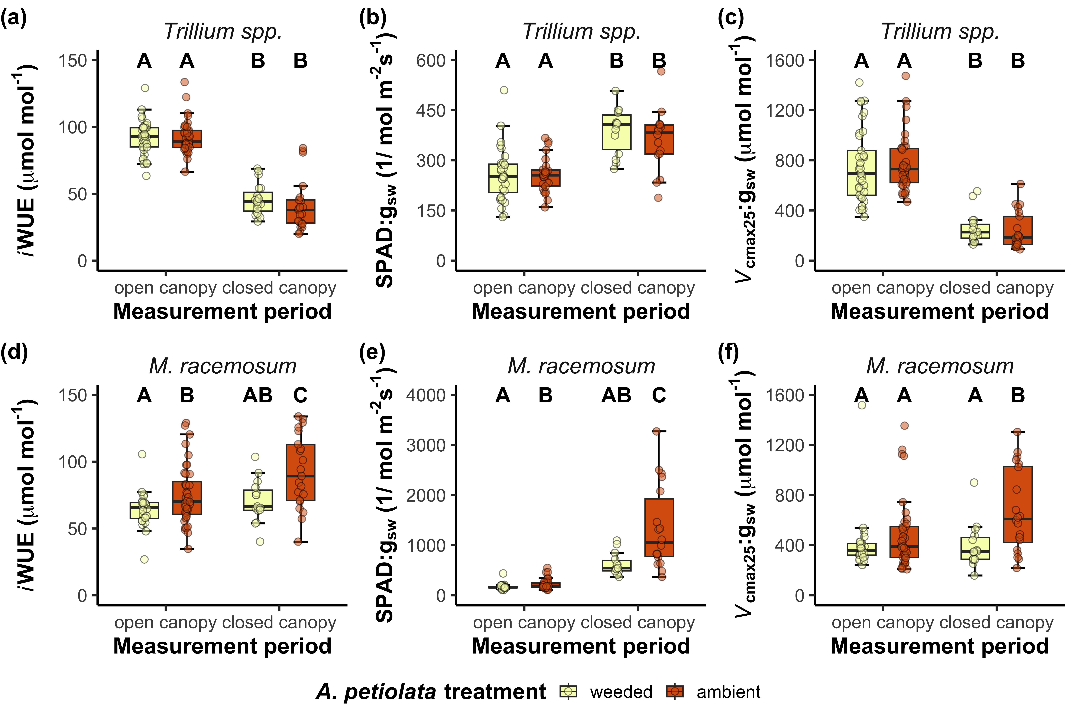
Garlic mustard decreases Trillium spp. photosynthetic capacity, but only later in the growth season

Slide 30
Garlic mustard decreases net photosynthesis through reduced stomatal conductance in M. racemosum

Slide 31
Garlic mustard has no effect on M. racemosum photosynthetic capacity

Slide 32
Conclusions
Positive effect
Negative effect
Photosynthetic capacity
Photosynthetic capacity
Garlic mustard presence
Leaf-level carbon assimilation
Garlic mustard presence
Leaf-level carbon assimilation
Stomatal conductance
Stomatal conductance
Maianthemum
racemosum
Trillium spp.

Slide 33
Conclusions
Native species’ responses to garlic mustard were strongest later in the growth season
Decreased nutrient availability could have increased reliance on AM fungal partners for nutrient uptake
Garlic mustard increased P limitation
Further increasing reliance on AM fungal partners?

Slide 34
Implications of climate change

Slide 35
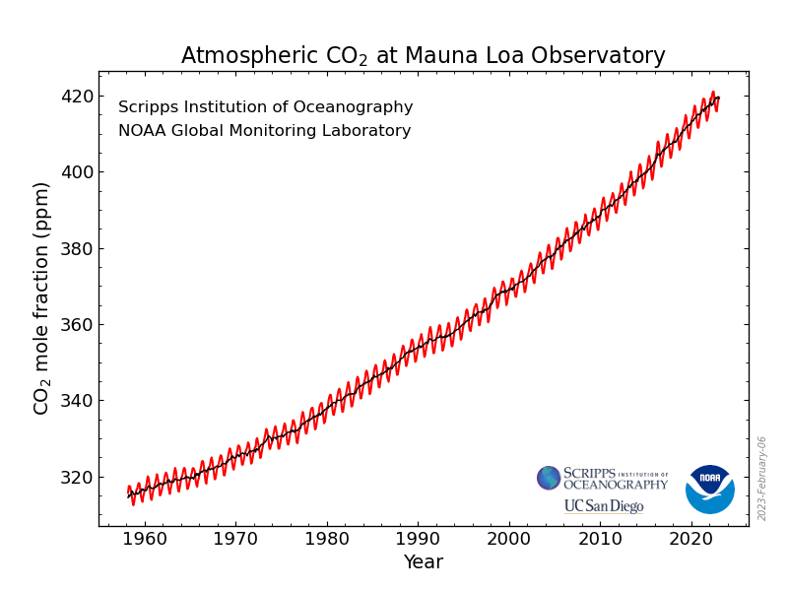
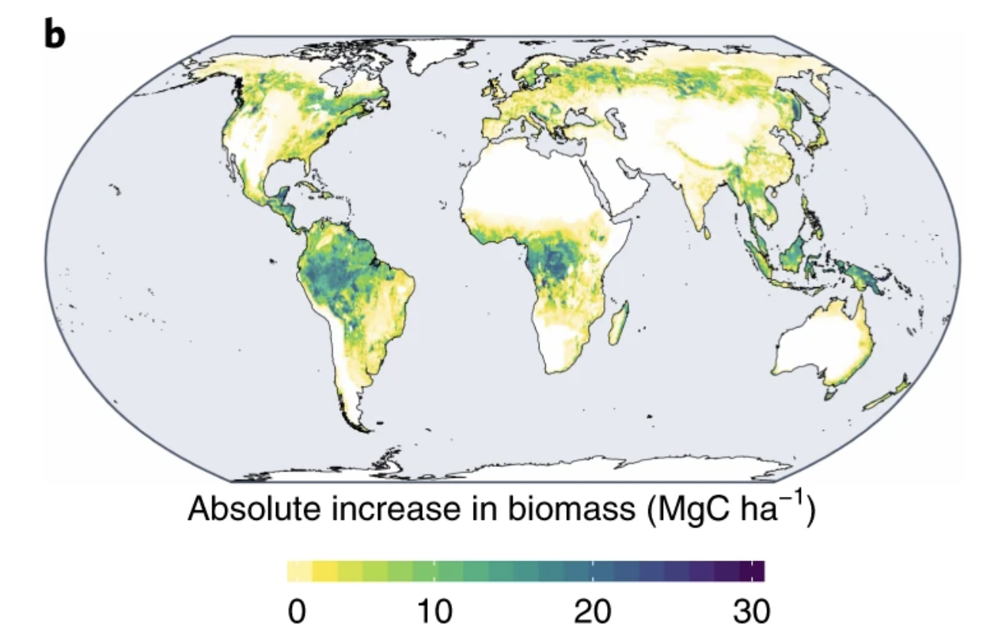
Implications of climate change
Increasing atmospheric CO₂ concentrations
Greater whole-plant biomass
Greater whole-plant photosynthesis
Greater allelochemical production?
Warming temperatures
Accelerates spring emergence
May increase nutrient depletion rates
May accelerate tree canopy closure
Terrer et al. (2019) Nature Climate Change

Slide 36
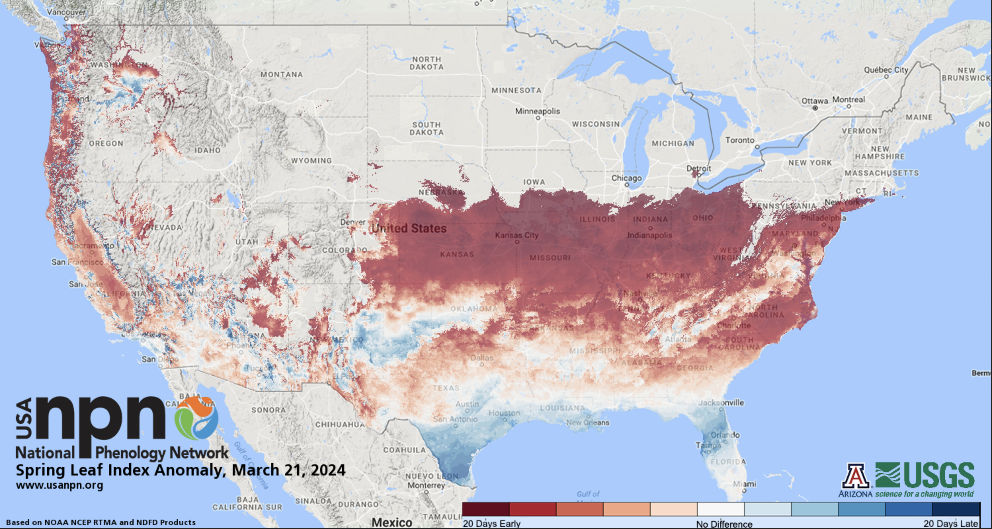
Implications of climate change
Increasing atmospheric CO₂ concentrations
Greater whole-plant biomass
Greater whole-plant photosynthesis
Greater allelochemical production?
Warming temperatures
Accelerates spring emergence
May increase nutrient depletion rates
May accelerate tree canopy closure

Slide 37
Next steps
How does garlic mustard influence seasonal carbon budgets of coexisting native flora?
How does reduced productivity in coexisting native flora scale to modify population demography and survivorship?

Slide 38
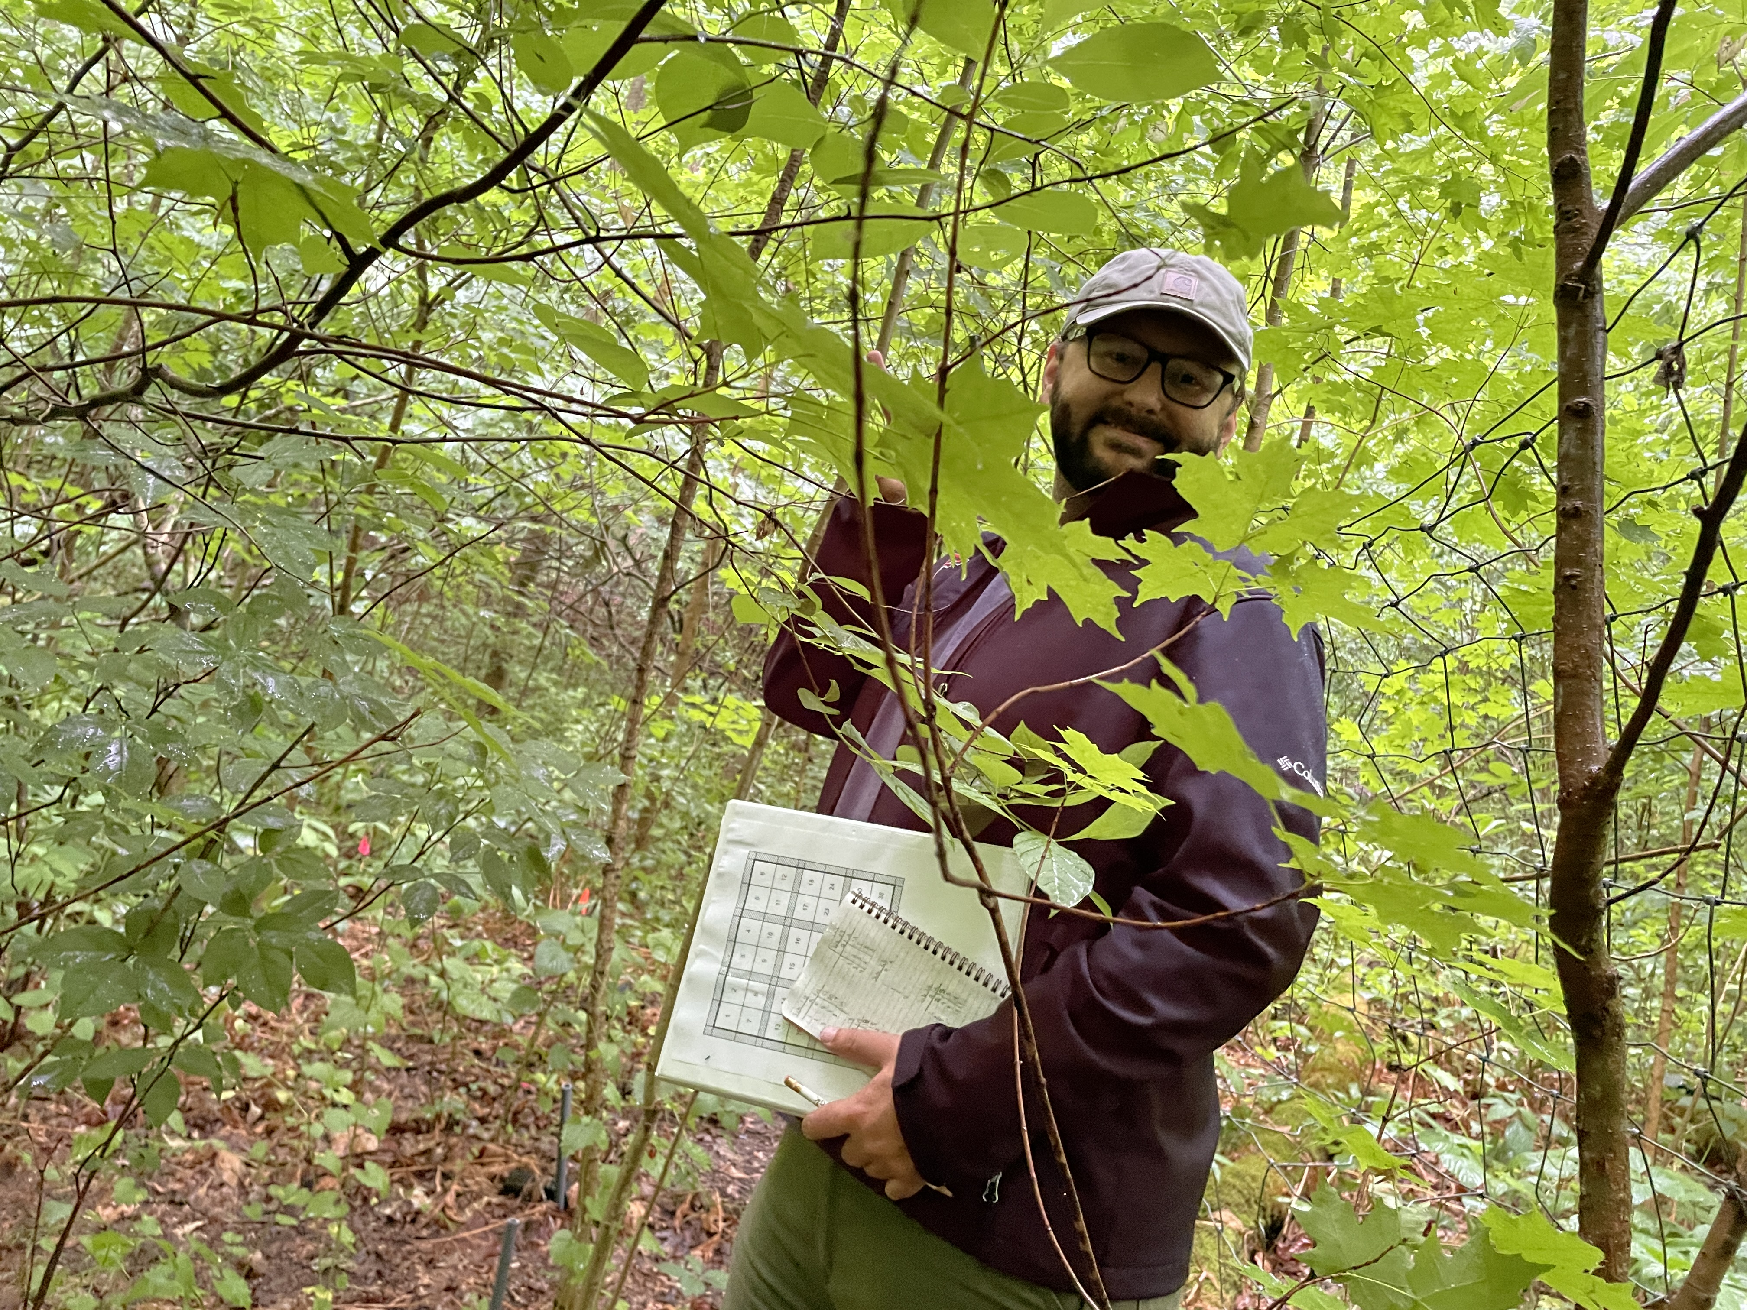
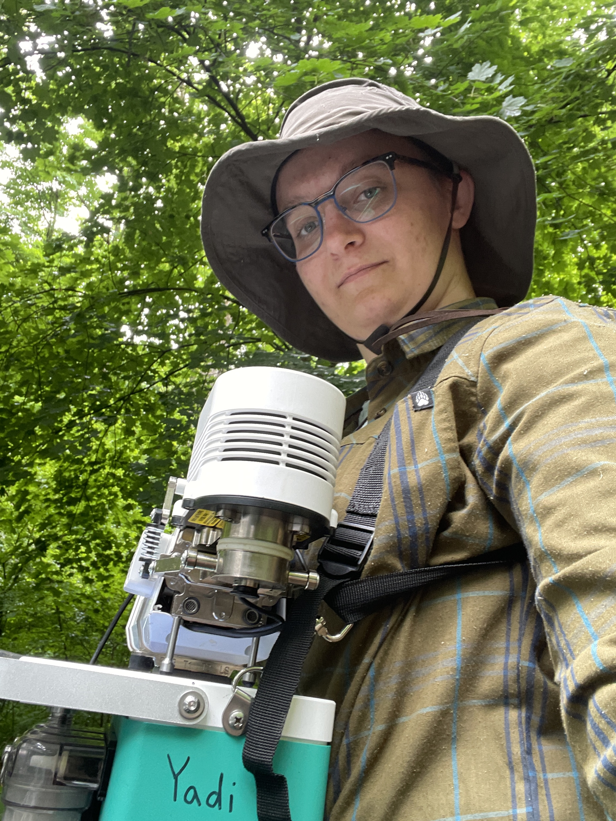
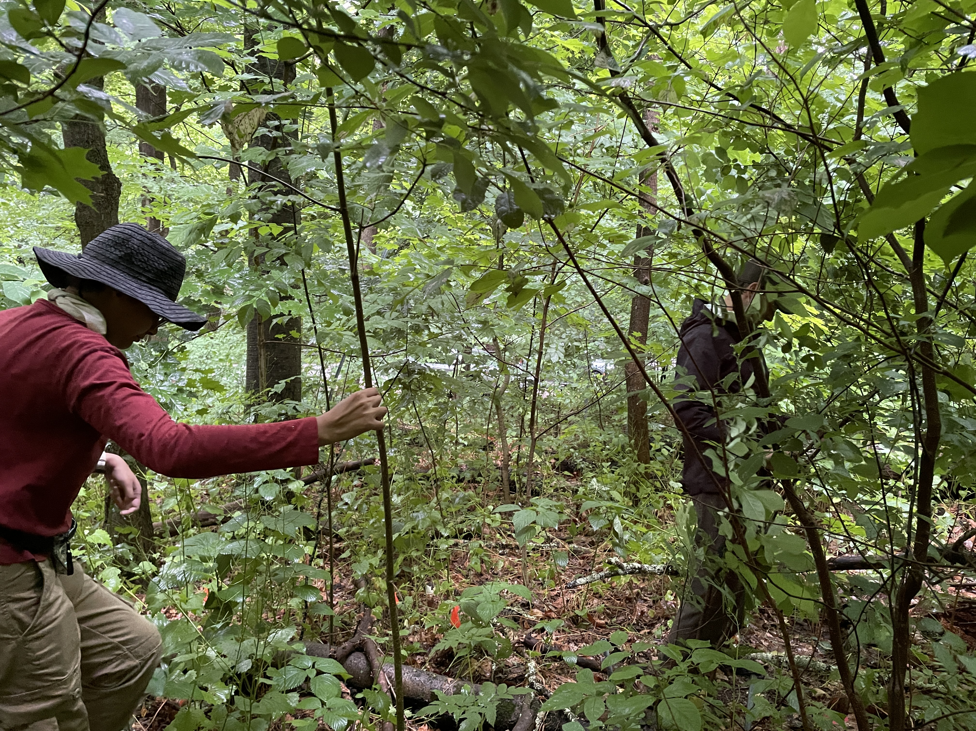
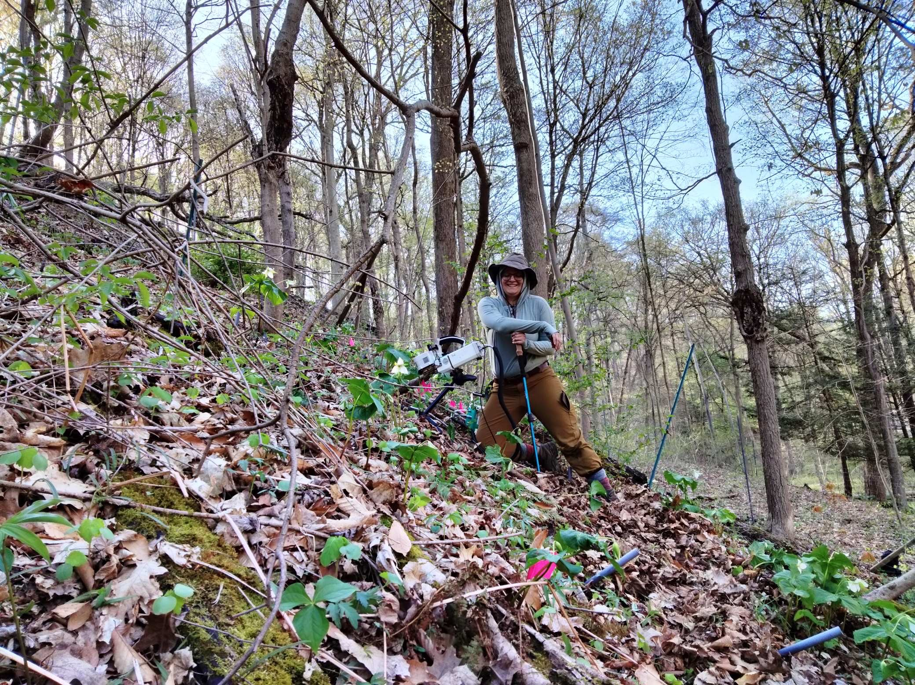
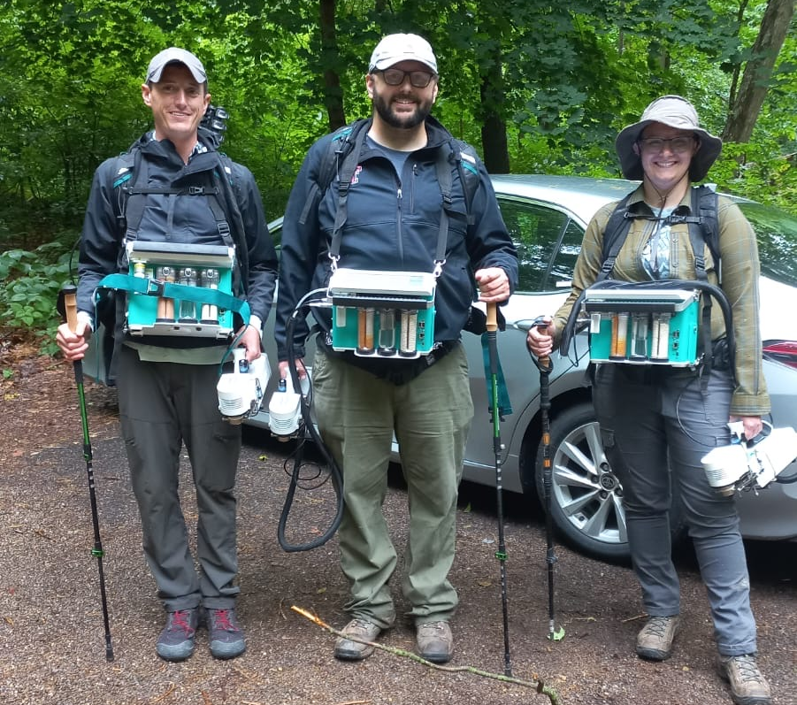
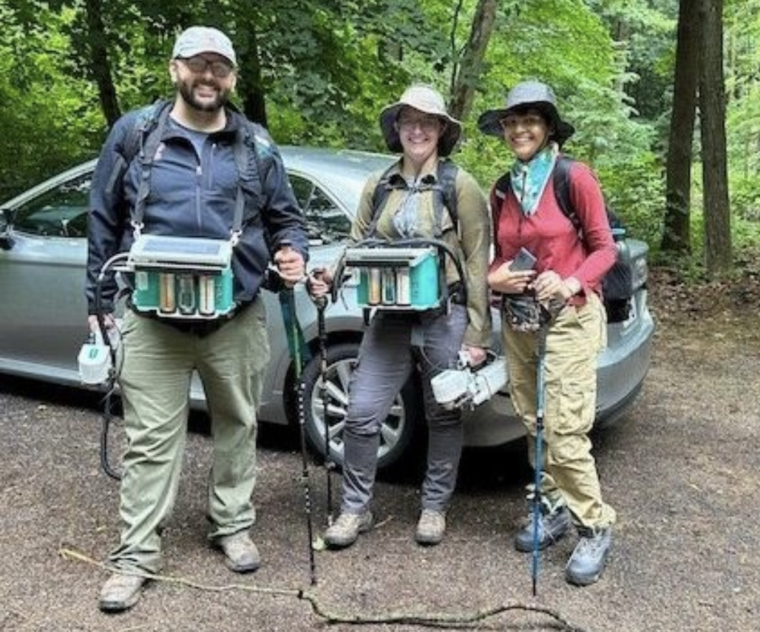
Thank you!
Please get in touch if you’d like to chat more about any of this or anything related to plant ecophysiology:
Evan Perkowski
Experimental Sciences II Room 409
evan.a.perkowski@ttu.edu

